Slide 1

ADVANCED 12 Lead EKG
18th Annual
North Douglas County
Rural EMS Retreat
March 2nd, 3rd & 4th, 2018

Slide 2
Jim Cole, LP, MAHE, NRP, FP-C, CEMSO, CMTE
jcole3@peacehealth.org
541-222-1794
Notes:
Describe the ECG characteristics, possible causes, signs and symptoms, and initial emergency care for premature junctional complexes (PJCs).
Describe the ECG characteristics and possible causes for junctional escape beats.
Explain the difference between premature junctional complexes and junctional escape beats.

Slide 3
Objectives
Develop a systematic approach to determine possible STEMI mimics.
Identify STEMI mimics and false EKG interpretations.
Notes:
Describe the ECG characteristics, possible causes, signs and symptoms, and initial emergency care for premature junctional complexes (PJCs).
Describe the ECG characteristics and possible causes for junctional escape beats.
Explain the difference between premature junctional complexes and junctional escape beats.

Slide 4
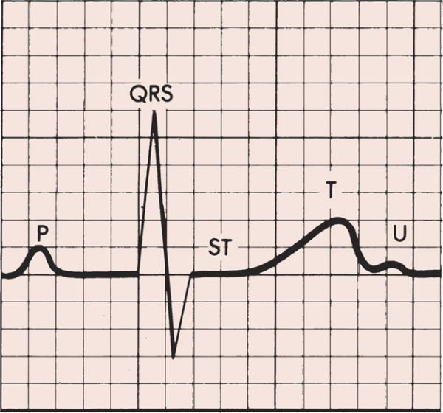
Introduction
ST segment of the cardiac cycle represents the period between depolarization and repolarization of the left ventricle
In normal state, ST segment is isoelectric relative to PR segment

Slide 5
Introduction
Most ST segment elevation is a result of non-AMI causes
    Otto LA, Aufderheide TP. Evaluation of ST segment elevation criteria for the prehospital electrocardiographic diagnosis fo acute myocardial infarction. Ann Emerg Med 1994; 23 (1):17-24.
    Chan TC, Brady WJ, Harrigan RA et al. ECG in Emergency Medicine and Acute Care. 1st ed. Pennsylvania: Elsevier Mosby; 2005.

Slide 6
Introduction
Of 123 adult chest pain patients with ST segment elevation ≥ 1mm, 63 patients (51%) did not have myocardial infarctions.
These non-MI were mainly
  LBBB (21%) and
  LVH (33%).
    Otto LA, Aufderheide TP. Evaluation of ST segment elevation criteria for the prehospital electrocardiographic diagnosis fo acute myocardial infarction. Ann Emerg Med 1994; 23 (1):17-24.

Slide 7
Causes of ST Segment Elevation
Acute Pericarditis
Benign Early Repolarization
Left Bundle Branch Block with AMI (Sgarbossa et al’s criteria)
Left Ventricular Hypertrophy
Left Ventricular Aneurysm
Brugada Syndrome
Hyperkalemia
Hypothermia
CNS pathologies
Prinzmetal Angina
Post electrical cardioversion

Slide 8
Acute Myocardial Infarction
Initial ST elevation as part of the classic evolutionary pattern of acute myocardial infarction was first described by Pardee in 1920
    Pardee HEB. An electrocardiographic sign of coronary artery obstruction. Arch Intern Med 1920; 26: 244–57.

Slide 9
Acute Myocardial Infarction
The exact reasons AMI produces ST segment elevation are complex and not fully understood
MI alters the electrical charge on the myocardial cell membranes and produce an abnormal current flow
    Goldberger: Clinical Electrocardiography: A Simplified Approach, 6th edition, 1999.

Slide 10
TP segment or PR segment?
ST segment elevation measured:
At J point – if relative to PR segment
At 0.06 – 0.08s from J point – if relative to TP segment
    Chan TC, Brady WJ, Harrigan RA et al. ECG in Emergency Medicine and Acute Care. 1st ed. Pennsylvania: Elsevier Mosby; 2005.

Slide 11
ST Segment Elevation Requirements
Study | Minimum Consecutive Leads | Minimum ST Elevation (mm) Limb leads | Minimum ST Elevation (mm) Precordial leads
AHA/ACC | 2 | 1 | 1
GISSI-1 | 1 | 1 | 2
GISSI-2 | 1 | 1 | 2
GUSTO | 2 | 1 | 2
TIMI | 2 | 1 | 1
TAMI | 2 | 1 | 1
Minnesota Code | 1 | 1 mm: I,II,III, aVL, aVF, V5-6 2mm: V1-V4

Slide 12
Minnesota Code
The Minnesota code 9-2 requires ≥1 mm ST elevation in one or more of leads I, II, III, aVL, aVF, V5, V6, or ≥ 2 mm ST elevation in one or more of leads V1–V4
    Menown IB, Mackenzie G, Adgey AA. Optimizing the initial 12-lead electrocardiographic diagnosis of acute myocardial infarction. Eur Heart J 2000; 21 (4):275-83.

Slide 13
Acute Myocardial Infarction
Irrespective of which definition is used, ST elevation has poor sensitivity for AMI where up to 50% of patients exhibit ‘atypical’ changes at presentation including isolated ST depression, T inversion or even a normal ECG
    Menown IB, Mackenzie G, Adgey AA. Optimizing the initial 12-lead electrocardiographic diagnosis of acute myocardial infarction. Eur Heart J 2000; 21 (4):275-83.

Slide 14
Acute Myocardial Infarction
ST segment elevation MI – persistent complete occlusion of an artery supplying a significant area of myocardium without adequate collateral circulation
UA/NSTEMI – result from non-occlusive thrombus, small risk area, brief occlusion, or an occlusion with adequate collaterals

Slide 15
How To Differentiate STE due to AMI from Other Causes?
Magnitude of the elevation
Morphology
Distribution
Prominent Electrical Forces (Voltage Amplitude)
QRS width
Other Features

Slide 16
Morphology of the ST Elevation

Slide 17
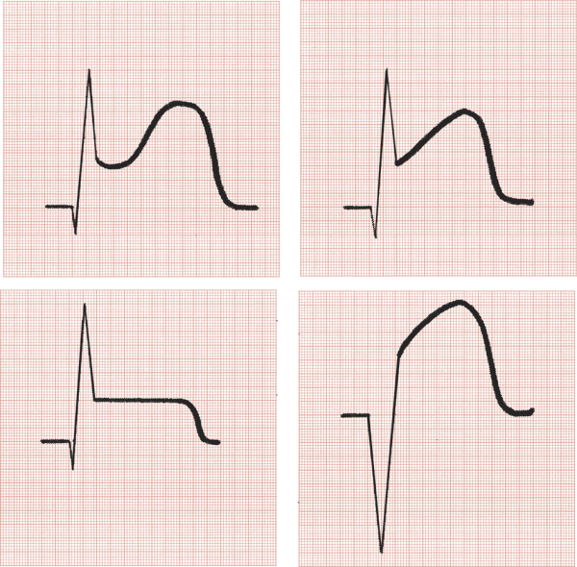
Variable Shapes Of ST Segment Elevations in AMI
Goldberger AL. Goldberger: Clinical Electrocardiography: A Simplified Approach. 7th ed: Mosby Elsevier; 2006.

Slide 18
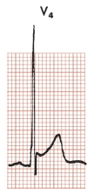
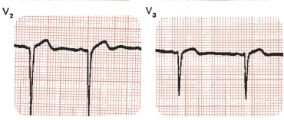
Morphology of STE
Concave shape STE – non AMI causes
AMI causes – usually demonstrate convex/straight STE
Apex of T wave
J point
Convex STE
Concave STE

Slide 19
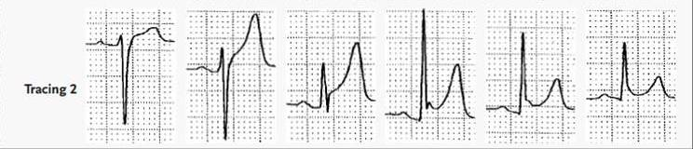
Benign Early Repolarization
Large amplitude T wave
Concave STE
Notching or slurring of J point

Slide 20
Benign Early Repolarization
ECG characteristics:
STE <2 mm
Concavity of initial portion of the ST segment
Notching or slurring of the terminal QRS complex
Symmetrical, concordant T wave of large amplitude
Widespread or diffuse distribution of STE
  Does not demonstrate territorial distribution
Relative temporal stability

Slide 21
Distribution

Slide 22
Distribution
STE due to AMI usually demonstrate regional or territorial pattern
  Examples:
  Anterior MI – V3-V4
  Septal MI – V2-V3
  Anteroseptal MI – V1/2 – V4/5
  Lateral MI – V5/V6
  Inferior MI – II, III, aVF
Diffuse STE – non AMI causes, e.g. pericarditis

Slide 23
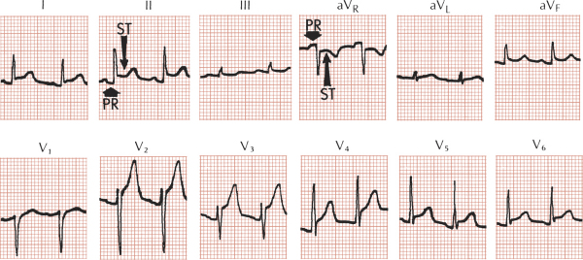
Pericarditis
Goldberger AL. Goldberger: Clinical Electrocardiography: A Simplified Approach. 7th ed: Mosby Elsevier; 2006.

Slide 24
Differentiating ECG Changes of AMI vs Pericarditis
STE in pericarditis – concave; AMI – obliquely flat or convex
STE in pericarditis – diffuse; AMI – territorial
PR Depression – pericarditis; Q in AMI
T inversion in pericarditis occurs only after ST normalized; T inversion accompanies STE in AMI (co-exist)

Slide 25
Pericarditis
Goldberger AL. Goldberger: Clinical Electrocardiography: A Simplified Approach. 7th ed: Mosby Elsevier; 2006.

Slide 26
Pericarditis
PR segment depression is usually transient but may be the earliest and most specific sign of acute myopericarditis
    Baljepally R, Spodick DH. PR-segment deviation as the initial electrocardiographic response in acute pericarditis. Am J Cardiol 1998; 81 (12):1505-6.

Slide 27
Acute Pericarditis – Four Classical Stages
First described by Spodick et al
Stage I
  first few days → 2 weeks
  STE, PR depression
Stage II
  last days → weeks
  Normalization of STE
Stage III
  after 2-3 weeks, lasts several weeks
  T wave inversion
Stage IV
  lasts up to several months
  gradual resolution of T wave changes
    Chan TC, Brady WJ, Pollack M. Electrocardiographic manifestations: acute myopericarditis. J Emerg Med 1999; 17 (5):865-72.

Slide 28
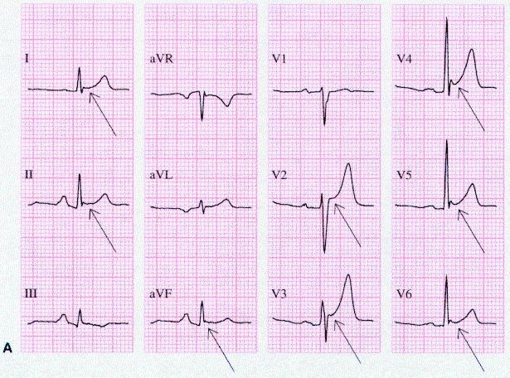
Stage 1 Pericarditis
PR Depression

Slide 29
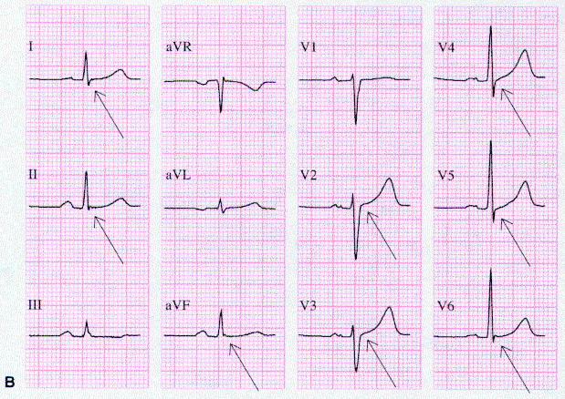
Stage 2 Pericarditis

Slide 30
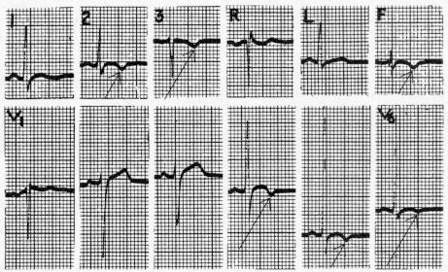
Stage 3 Pericarditis

Slide 31
ECG Changes of Pericarditis vs Benign Early Repolarization
Both demonstrate initial concavity of upsloping ST segment/T wave
PR depression in pericarditis; not in BER
ST/T Ratio
  ST/T ratio ≥ 0.25 – pericarditis
  ST/T ratio < 0.25 – BER
    Ginzton LE, Laks MM. The differential diagnosis of acute pericarditis from the normal variant: new electrocardiographic criteria. Circulation 1982; 65 (5):1004-9.

Slide 32
Brugada Syndrome:
ECG patterns
RBBB
ST Elevations limited to right precordial leads V1 and V2
Saddle shaped or coved shaped ST elevation
First described in 1992 by Brugada and Brugada
The syndrome has been linked to mutations in the cardiac sodium-channel gene
    Amal Mattu, Robert L. Rogers, Hyung Kim, Andrew D. Perron and William J. Brady. The Brugada Syndrome. The American Journal of Emergency Medicine, Vol. 21, No. 2, March 2003

Slide 33
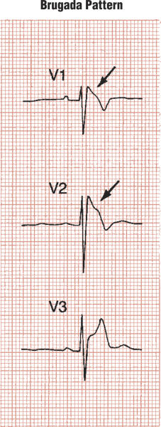
ST Elevation morphologies in Brugada Syndrome
RBBB with RSR pattern rather than rSR pattern and there is associated STE

Slide 34
QRS Width

Slide 35
Left Bundle Branch Block
In LBBB, the QRS complex is broad with negative QS or rS complex in lead V1, and may demonstrate STE
What if, LBBB co-exist with STEMI?
    Chan TC, Brady WJ, Harrigan RA et al. ECG in Emergency Medicine and Acute Care. 1st ed. Pennsylvania: Elsevier Mosby; 2005.

Slide 36
Sgarbossa Criteria
Sgarbossa et al. have developed a clinical prediction rule to assist in the ECG diagnosis of AMI in the setting of LBBB using three specific ECG findings
    Sgarbossa EB, Pinski SL, Barbagelata A, et al. Electrocardiographic diagnosis of evolving acute myocardial infarction in the presence of left bundle-branch block. N Engl J Med 1996; 334:481-7.

Slide 37
Sgarbossa Criteria
ST Elevation ≥ 1 mm and concordant with QRS complex | Score 5 points Odds Ratio (OR) 25.2
ST Depression ≥ 1 mm in V1, V2, V3 | Score 3 points OR 6.0
ST Elevation ≥ 5 mm and discordant with QRS complex | Score 2 points OR 4.3
Odds Ratio: a measure of the degree of association; for example, the odds of exposure among the cases compared with the odds of exposure among the controls (www.cefpas.it/ebm/tools/glossary.htm)

Slide 38
AMI in the presence of LBBB

Slide 39
Sgarbossa Criteria
A total score of 3 or more suggests that the patient is likely experiencing an AMI based on the ECG crtieria
With a score less than 3, the ECG diagnosis is less certain requiring additional evaluation
    Chan TC, Brady WJ, Harrigan RA et al. ECG in Emergency Medicine and Acute Care. 1st ed. Pennsylvania: Elsevier Mosby; 2005.

Slide 40
Sgarbossa Criteria
Subsequent publications have suggested that Sgarbossa’s criteria is less useful than reported, with studies demonstrating decreased sensitivity and inter-rater reliability
    Shlipak MG, Lyons WL, Go AS et al. Should the electrocardiogram be used to guide therapy for patients with left bundle-branch block and suspected myocardial infarction? Jama 1999; 281 (8):714-9.
    Edhouse JA, Sakr M, Angus J et al. Suspected myocardial infarction and left bundle branch block: electrocardiographic indicators of acute ischaemia. J Accid Emerg Med 1999; 16 (5):331-5.

Slide 41
Prominent Electrical Forces

Slide 42
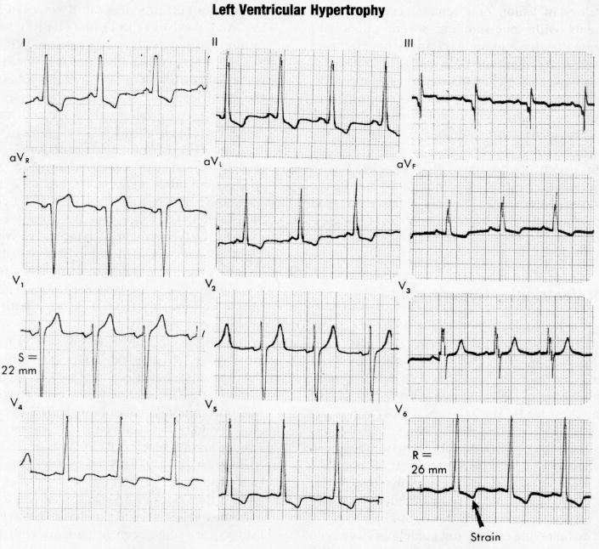
Left Ventricular Hypertrophy

Slide 43
ECG Diagnostic Criteria for LVH
 | Sensitivity | Specificity
Sokolow-Lyon Index SV1 + (RV5 or RV6)>35mm | 22 | 100
Cornell Voltage Criteria SV3+RaVL>28 mm (men), 20mm(women) | 42 | 96
R1 + SIII>25 mm | 11 | 100
R in aVL> 11mm | 11 | 100
Other Criteria include Romhilt and Estes Point Score System
    Chan TC, Brady WJ, Harrigan RA et al. ECG in Emergency Medicine and Acute Care. 1st ed. Pennsylvania: Elsevier Mosby; 2005.

Slide 44
ECG Changes of Left Ventricular Hypertrophy vs AMI
The initial upsloping of the elevated ST segment is frequently concave in LVH as opposed to the more likely flat/convex ST segment elevation in ACS
The T wave is usually asymmetrical in LVHas opposed to the symmetrical T wave seen in coronary ischemia

Slide 45
Case Study #1

Slide 46
Case Study #1
A 62-year-old African American man is complaining of substernal chest pain that began 30 minutes ago.
  He rates his pain 8/10 and states his pain radiates to his left jaw.

Slide 47
Case Study #1
The patient, a plumber, is 6 feet tall and weighs 195 pounds.
He was carrying a load of plumbing supplies to his truck when his symptoms began.
  He denies a history of similar episodes.
The patient has a history of frequent sinus infections for which he is currently taking Keflex.

Slide 48
Case Study #1
The patient states his father died at age 55 from a heart attack.
His mother is living and has no significant medical problems.
He enjoys scuba diving and golf.
He does not smoke and has no medication allergies.

Slide 49
Case Study #1
Physical examination
Awake and oriented to person, place, time, and event.
Skin: Warm and moist.
Mucous membranes: Pink.
No jugular vein distention.
Breath sounds clear and equal bilaterally.

Slide 50
Case Study #1
Initial vital signs
  Blood pressure 150/100
  Pulse 72
  Ventilatory rate 16
  SpO₂ 97% on room air
25 minutes later
  Blood pressure 144/98
  Pulse 76
  Ventilatory rate 16

Slide 51
Case Study #1
Supplemental oxygen has been applied.
Vascular access has been obtained.
Cardiac monitor applied.
12-Lead ECG obtained.

Slide 52
Case Study #1
Does this patient have any risk factors for coronary artery disease?
Notes:
Important patient risk factors in this situation include the patient’s race, family history of coronary artery disease, and age.

Slide 53
Case Study #1
What immediate interventions should be performed for this patient?
Notes:
Initial treatment:
ABCs, oxygen, vascular access, administer aspirin 162 to 325 mg (chewed) if no reason for exclusion. Obtain a 12-Lead ECG (already done).

Slide 54
Case Study #1
A 12-lead ECG has been obtained.
Based on the ECG, the patient should be categorized into one of three groups.
Can you name them?
Notes:
Obtain a 12-lead ECG (already done) and categorize the patient into one of three groups:
STEMI (characterized by ST-segment elevation)
High-risk unstable angina/NSTEMI (characterized by ST-segment depression)
Intermediate or low-risk unstable angina (characterized by normal or nondiagnostic ST segment or T wave changes)

Slide 55
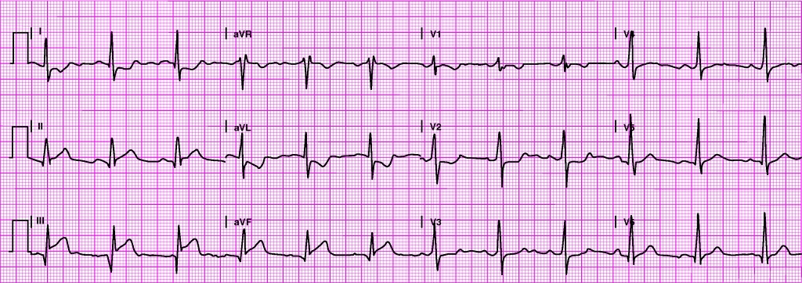
Case Study #1
What does the patient’s 12-lead show?
Notes:
Underlying rhythm? Sinus rhythm at 72 bpm
Pathologic Q waves? Leads: III
ST-segment elevation? Leads: II, III, aVF
PR interval 188 ms, QRS 116 ms QT/QTc 400/424 ms P-R-T axes 31 54 87
Interpretation: Inferior infarction with posterior extension (prominent R wave in V₁/V₂).

Slide 56
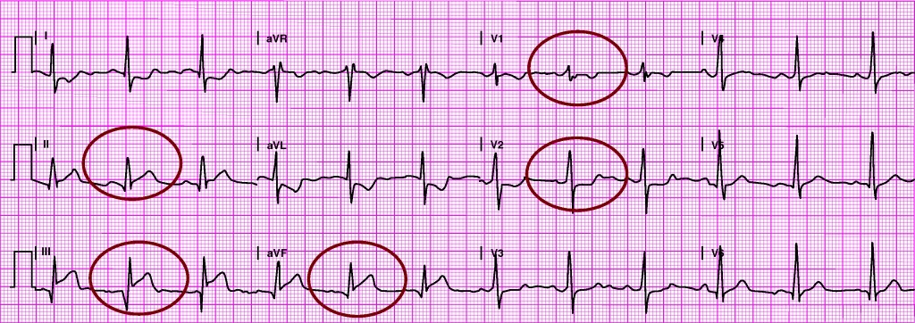
Case Study #1
What does the patient’s 12-lead show?
Notes:
Underlying rhythm? Sinus rhythm at 72 bpm
Pathologic Q waves? Leads: III
ST-segment elevation? Leads: II, III, aVF
PR interval 188 ms, QRS 116 ms QT/QTc 400/424 ms P-R-T axes 31 54 87
Interpretation: Inferior infarction with posterior extension (prominent R wave in V₁/V₂).

Slide 57
Case Study #1
Underlying rhythm?
  Sinus rhythm at 72 bpm
Pathologic Q waves?
  Leads: III
ST-segment elevation?
  Leads: II, III, aVF
PR interval 188 ms, QRS 116 ms
QT/QTc 400/424 ms; P-R-T axes 31 54 87
Interpretation: Inferior infarction with posterior extension (prominent R wave in V₁/V₂). Obtain V₄R to assess for right ventricular infarction.
Notes:
Underlying rhythm? Sinus rhythm at 72 bpm
Pathologic Q waves? Leads: III
ST-segment elevation? Leads: II, III, aVF
PR interval 188 ms, QRS 116 ms QT/QTc 400/424 ms P-R-T axes 31 54 87
Interpretation: Inferior infarction with posterior extension (prominent R wave in V₁/V₂).

Slide 58
Case Study #1
Describe your immediate general treatment for this patient.
Notes:
The patient’s initial 12-lead ECG shows evidence of a STEMI. Using a reperfusion checklist, begin evaluating the patient for rapid reperfusion therapy (fibrinolytic therapy or percutaneous coronary intervention). Obtain serial 12-lead ECGs, lab specimens (cardiac biomarkers, CBC, lipid profile, electrolytes), and a portable chest radiograph. Administer medications for pain relief as necessary while closely monitoring the patient’s vital signs.

Slide 59
Case Study #2

Slide 60
Case Study #2
A 50-year-old woman presents with a complaint of nausea, lightheadedness, and “pain between my shoulder blades” that has been present for about 2 hours.
The patient, an accountant, states she was working at her desk when her symptoms began.
Pain has steadily increased in intensity.
  Rates her discomfort 9/10.
Denies any recent unusual physical activity
or illness.

Slide 61
Case Study #2
The patient is 5 feet 5 inches and weighs 190 pounds.
History of hypertension for which she takes lisinopril (Prinivil, Zestril) daily.
Mother died at age 72 of breast cancer.
Father, age 74, is living and had a coronary artery bypass graft at age 62.

Slide 62
Case Study #2
Physical examination
Awake and oriented to person, place, time, and event.
Skin: Pink, warm, and moist.
No jugular vein distention.
Very anxious and breathing rapidly:
  Breathing does not appear labored.
  Breath sounds clear and equal bilaterally.

Slide 63
Case Study #2
Initial vital signs
  Blood pressure 178/104
  Pulse 83
  Ventilatory rate 32
  SpO₂ 98% on room air
12 minutes later
  Blood pressure 164/90
  Pulse 77
  Ventilatory rate 24

Slide 64
Case Study #2
Does this patient have any risk factors for coronary artery disease?
Notes:
Important patient risk factors in this situation include the patient’s family history of coronary artery disease, sedentary lifestyle, history of hypertension, obesity, and age.

Slide 65
Case Study #2
What immediate interventions should be performed for this patient?
Notes:
Initial treatment:
ABCs, oxygen, vascular access, administer aspirin 162 to 325 mg (chewed) if no reason for exclusion. Obtain a 12-Lead ECG.

Slide 66
Case Study #2
Supplemental oxygen has been applied.
Vascular access has been obtained.
Cardiac monitor applied.
12-Lead ECG obtained.

Slide 67
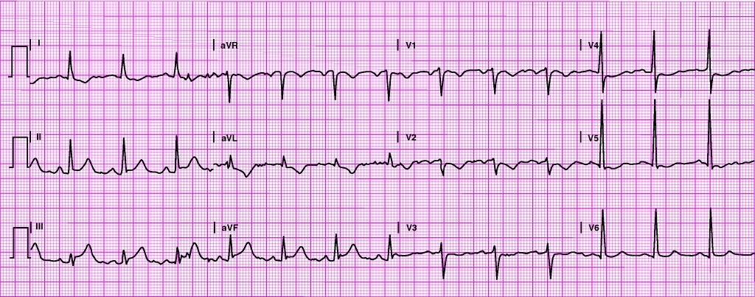
Case Study #2
Time: 4:32:58 p.m.
What does the patient’s 12-lead show?

Slide 68
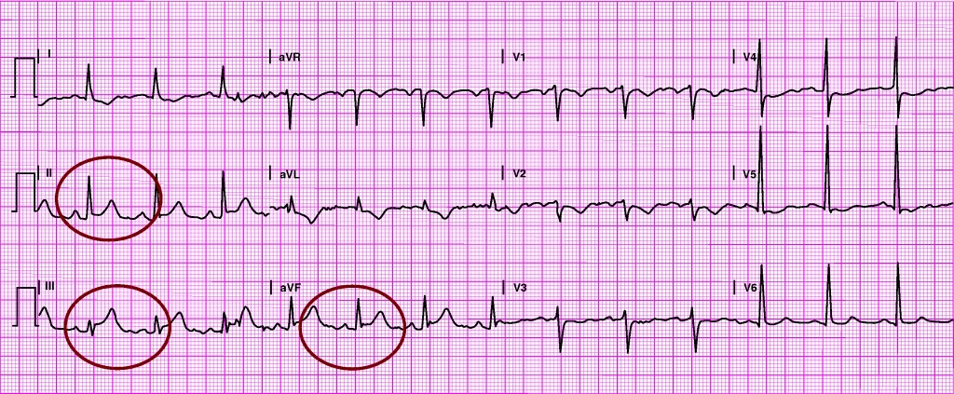
Case Study #2
Time: 4:32:58 p.m.
What does the patient’s 12-lead show?
Notes:
Underlying rhythm? Sinus rhythm at 83 bpm
ST-segment elevation? Leads: II, III, aVF
ST-segment depression? Leads: I, aVL, V₁-V₆
T wave changes? Leads: Inverted in I, aVL, V₁-V₅
PR interval 172 ms, QRS 108 ms
QT/QTc 364/403 ms
P-R-T axes 67 52 100
Interpretation: Possible inferior infarction, possible anterolateral ischemia; reciprocal changes present. Obtain V₄R to assess for right ventricular infarction.

Slide 69
Case Study #2
Underlying rhythm? Sinus rhythm at 83 bpm
ST-segment elevation? Leads: II, III, aVF
ST-segment depression? Leads: I, aVL, V₁-V₆
T wave changes? Leads: Inverted in I, aVL, V₁-V₅
PR interval 172 ms, QRS 108 ms
QT/QTc 364/403 ms
P-R-T axes 67 52 100
Interpretation:
  Possible inferior infarction, possible anterolateral ischemia; reciprocal changes present.
  Obtain V₄R to assess for right ventricular infarction.
Notes:
Underlying rhythm? Sinus rhythm at 83 bpm
ST-segment elevation? Leads: II, III, aVF
ST-segment depression? Leads: I, aVL, V₁-V₆
T wave changes? Leads: Inverted in I, aVL, V₁-V₅
PR interval 172 ms, QRS 108 ms
QT/QTc 364/403 ms
P-R-T axes 67 52 100
Interpretation: Possible inferior infarction, possible anterolateral ischemia; reciprocal changes present. Obtain V₄R to assess for right ventricular infarction.

Slide 70
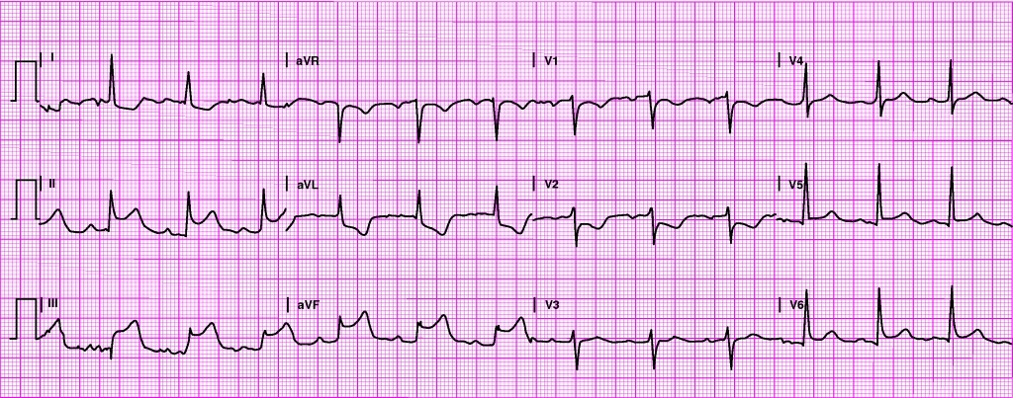
Case Study #2
Time: 4:44:36 p.m.
What does the patient’s 12-lead show?

Slide 71
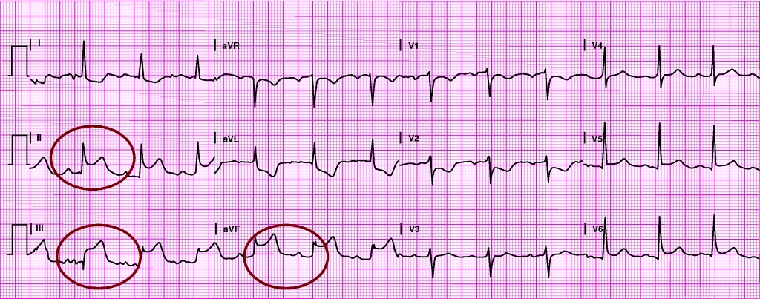
Case Study #2
Time: 4:44:36 p.m.
What does the patient’s 12-lead show?
Notes:
Underlying rhythm? Sinus rhythm at 77 bpm with first-degree AV block
Pathologic Q waves? Leads: III?
ST-segment elevation? Leads: II, III, aVF
ST-segment depression? Leads: I, aVL, V₁-V₂
T wave changes? Leads: Inverted in I, aVL, V₁-V₂
PR interval 224 ms
QRS 104 ms
QT/QTc 404/436 ms
P-R-T axes 62 28 101
Interpretation: Inferior infarction, reciprocal changes present

Slide 72
Case Study #2
Underlying rhythm? Sinus rhythm at 77 bpm with first-degree AV block
Pathologic Q waves? Leads: III?
ST-segment elevation? Leads: II, III, aVF
ST-segment depression? Leads: I, aVL, V₁-V₂
T wave changes? Leads: Inverted in I, aVL, V₁-V₂
PR interval 224 ms; QRS 104 ms
QT/QTc 404/436 ms
P-R-T axes 62 28 101
Interpretation: Inferior infarction, reciprocal changes present. Obtain V₄R to assess for right ventricular infarction.
Notes:
Underlying rhythm? Sinus rhythm at 77 bpm with first-degree AV block
Pathologic Q waves? Leads: III?
ST-segment elevation? Leads: II, III, aVF
ST-segment depression? Leads: I, aVL, V₁-V₂
T wave changes? Leads: Inverted in I, aVL, V₁-V₂
Interpretation: Inferior infarction, reciprocal changes present. Obtain V₄R to assess for right ventricular infarction.
PR interval 224 ms
QRS 104 ms
QT/QTc 404/436 ms
P-R-T axes 62 28 101

Slide 73
Case Study #2
Describe your immediate general treatment for this patient.
Notes:
ABCs, oxygen, vascular access, administer aspirin 162 to 325 mg (chewed) if no reason for exclusion. Obtain a 12-Lead ECG (already done). The patient’s 12-Lead ECG shows ST-segment elevation in leads II, III, and aVF. A right-sided 12-Lead should be obtained and evaluated for possible right ventricular MI. Complete a reperfusion therapy checklist, obtain lab specimens (serum cardiac markers, CBC, lipid profile, electrolytes), and a portable chest radiograph. Since breath sounds are clear, strongly consider a fluid challenge before administering medications for pain relief. Monitor the patient’s vital signs closely.
This patient’s second ECG shows a sinus rhythm with a first-degree AV block. Remember that first-degree AV block that occurs with acute myocardial infarction should be monitored closely. Assuming that signs of right ventricular infarction are not present, general management of this patient’s infarction is the same as that presented in Case Study #1.

Slide 74
Case Study #3

Slide 75
Case Study #3
A 24-year-old, 6-foot 2-inch, 180-pound, Caucasian college student presents for a routine physical examination before participating in a college-sponsored sports marathon.
The patient states he is an avid sports enthusiast and maintains a healthy lifestyle.
His primary sports activities include distance running, swimming, cycling, and rowing.

Slide 76
Case Study #3
The patient denies any history of syncope, near-syncope, or palpitations.
No family history of sudden cardiac death, Marfan syndrome, or hypertrophic cardiomyopathy.

Slide 77
Case Study #3
Physical examination
Awake and oriented to person, place, time, and event.
Tall and thin with a muscular build.
Skin: Pink, warm, dry.
Breath sounds are clear and equal bilaterally.

Slide 78
Case Study #3
Vital signs
Blood pressure 108/73.
Pulse 76.
Ventilatory rate 18.
SpO₂ 98% on room air.

Slide 79
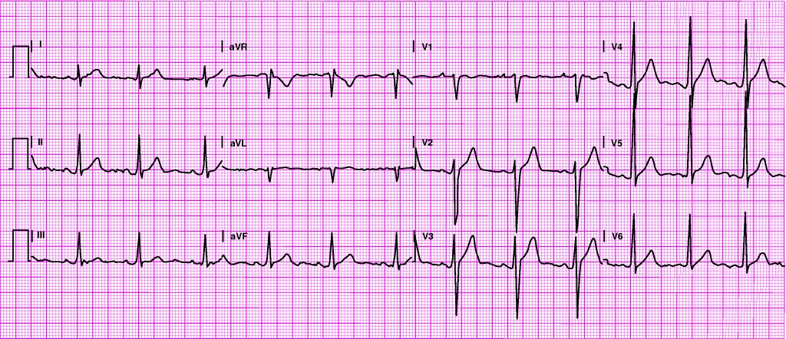
Case Study #3
What does the patient’s 12-lead show?

Slide 80
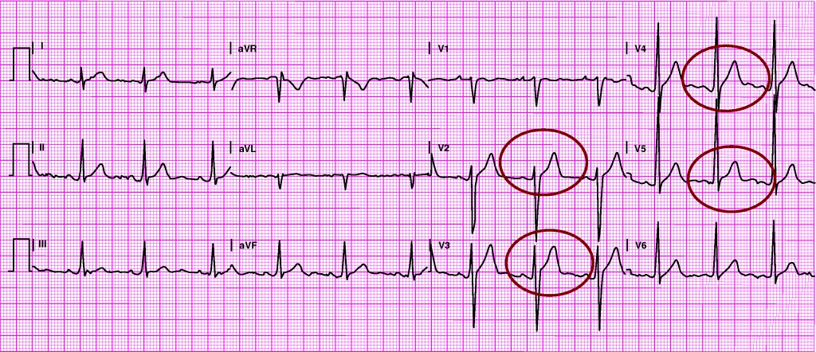
Case Study #3
What does the patient’s 12-lead show?
Notes:
Underlying rhythm? Sinus rhythm at 76 bpm
ST-segment elevation? V₂-V₅
T wave changes? Inverted in V₁
PR interval 160 ms, QRS 108 ms
QT/QTc 384/414 ms
P-R-T axes 67 79 52
Interpretation: Benign early repolarization (ST-segment elevation with normally inflected T wave)

Slide 81
Case Study #3
Underlying rhythm? Sinus rhythm at 76 bpm
ST-segment elevation? V₂-V₅
T wave changes? Inverted in V₁
PR interval 160 ms, QRS 108 ms
QT/QTc 384/414 ms
P-R-T axes 67 79 52
Interpretation: Benign early repolarization (ST-segment elevation with normally inflected T wave)

Slide 82
Case Study #3
Describe your immediate general treatment for this patient.

Slide 83
Case Study #3
This patient requires no specific treatment.
Common ECG abnormalities that may be seen in athletes:
  A striking increase of R- or S-wave voltage (suggesting left ventricular hypertrophy and/or right ventricular hypertrophy)
  ST-segment depression or elevation (including an early repolarization pattern)
  Flat or deeply inverted T waves
  Deep Q waves
  Incomplete RBBB
  Sinus arrhythmia, bradycardia, first-degree AV block, and second-degree AV block type I
Notes:
This patient requires no specific treatment. Common ECG abnormalities that may be seen in athletes include a striking increase of R or S wave voltage (suggesting left ventricular hypertrophy and/or right ventricular hypertrophy), ST-segment depression or elevation (including an early repolarization pattern), either flat or deeply inverted T waves, deep Q waves, incomplete RBBB, sinus arrhythmia, bradycardia, first-degree AV block, and second-degree AV block type I. Athletic training causes an increase in left ventricular (LV) mass due to increased thickness of the LV wall (hypertrophy), dilatation, or both. Differentiation between the physiologic hypertrophy that occurs with athletic training and hypertrophic cardiomyopathy is important. Hypertrophic cardiomyopathy (HCM) has been associated with sudden death in young patients, frequently during athletic competition. At present, there is no single approach that will definitively differentiate between “athlete’s heart” and hypertrophic cardiomyopathy. An echocardiogram may be performed to evaluate wall thickness and systolic function.

Slide 84
Case Study #4

Slide 85
Case Study #4
A 68-year-old Native American man presents with a sudden onset of chest pressure accompanied by mild dyspnea.
He rates his discomfort 8/10 and states his symptoms have been present for approximately 20 minutes.

Slide 86
Case Study #4
Patient is 5 feet 10 inches and weighs about 300 pounds.
History of diabetes, high cholesterol, and hypertension for which he has been prescribed medication.
  Stopped taking his meds about 3 weeks ago because they are expensive and he is on a fixed income.
Extensive family history of early coronary artery disease.

Slide 87
Case Study #4
Physical examination
Awake and oriented to person, place, time, and event.
Skin: Pale, cool, moist.
No jugular vein distention.
Anxious.
States he feels as if he is going to die.
Breath sounds reveal slight basilar crackles.

Slide 88
Case Study #4
Vital signs
Spo₂ 95% on room air.
Blood pressure 160/110.
Pulse 57.
Ventilatory rate 24.

Slide 89
Case Study #4
Does this patient have any risk factors for coronary artery disease?
Notes:
Important patient risk factors in this situation include the patient’s age, obesity, history of diabetes, hyperlipidemia, and hypertension, and extensive family history of coronary artery disease.

Slide 90
Case Study #4
What immediate interventions should be performed for this patient?
Notes:
ABCs, oxygen, vascular access, and administer aspirin 162 to 325 mg (chewed) if no reason for exclusion. Obtain a 12-Lead ECG.

Slide 91
Case Study #4
Supplemental oxygen has been applied.
Vascular access has been obtained.
Cardiac monitor applied.
12-Lead ECG obtained.

Slide 92
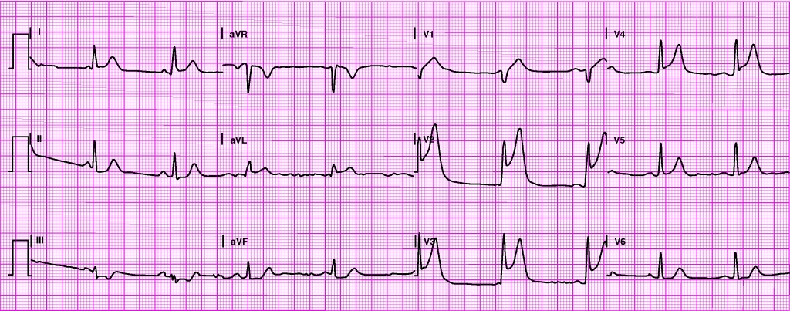
Case Study #4
What does the patient’s 12-lead show?

Slide 93
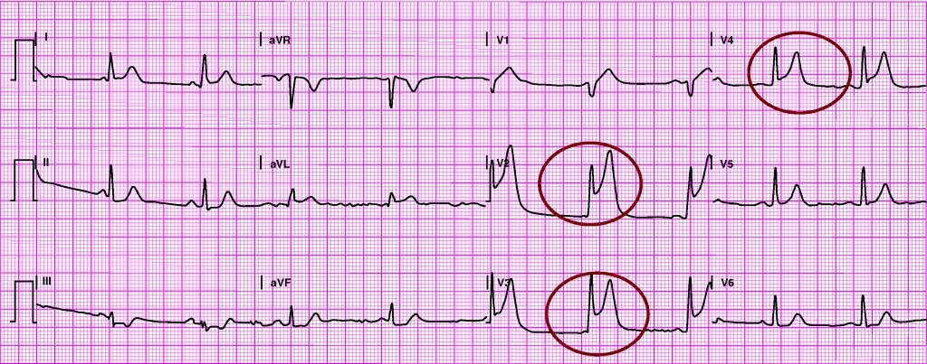
Case Study #4
What does the patient’s 12-lead show?
Notes:
Baseline wander or artifact? Baseline wander in I, II, III
Underlying rhythm? Sinus bradycardia at 57 bpm
Pathologic Q waves? V₁?
ST-segment elevation? V₂-V₄
ST-segment depression? Leads: II, III, aVF
T wave changes? Inverted in III?
PR interval 172 ms
QRS 84 ms
QT/QTc 380/375 ms
P-R-T axes 68 21 22
Interpretation: Anterior infarction

Slide 94
Case Study #4
Baseline wander or artifact? Baseline wander in I, II, III
Underlying rhythm? Sinus bradycardia at 57 bpm
Pathologic Q waves? V₁ ?
ST-segment elevation? V₂-V₄
ST-segment depression? Leads: II, III, aVF
T wave changes? Inverted in III?
PR interval 172 ms; QRS 84 ms
QT/QTc 380/375 ms
P-R-T axes 68 21 22
Interpretation: Anterior infarction

Slide 95
Case Study #4
Describe your immediate general treatment for this patient.

Slide 96
Case Study #4
ABCs, oxygen, vascular access.
Administer aspirin.
Reperfusion therapy checklist.
Lab specimens, portable chest radiograph.
Administer medications for pain relief.
  Monitor vital signs closely

Slide 97
Case Study #4
12-Lead ECG shows evidence of anterior infarction.
Anticipate complications:
  Left ventricular dysfunction
    Including heart failure and cardiogenic shock
  Dysrhythmias
    PVCs, atrial flutter, atrial fibrillation common
  Bundle branch blocks may result.

Slide 98
Case Study #5

Slide 99
Case Study #5
A 51-year-old Caucasian woman is complaining of substernal chest pressure that started 3 hours ago.
  She states the pressure radiates to her left neck and ear.

Slide 100
Case Study #5
The patient says her symptoms began at rest.
She rates her discomfort 8/10 after taking a nitroglycerin tablet.

Slide 101
Case Study #5
The patient has a history of angina, heart failure, high cholesterol, and arthritis.
Current medications include:
  Lipitor Nitroglycerin
  Lasix Naprosyn
  Fosamax Allegra
  Prilosec Potassium chloride
  Nexium Isosorbide
She does not smoke and has no medication allergies.

Slide 102
Case Study #5
Physical examination
Awake and oriented to person, place, time, and event.
Skin: Warm and dry.
Mucous membranes: Pink.
No jugular vein distention.
Breath sounds clear and equal bilaterally.

Slide 103
Case Study #5
Initial vital signs
  Blood pressure 154/74
  Pulse 140
  Ventilatory rate 12
  Spo₂ 98% on room air
10 minutes later
  Blood pressure 140/82
  Pulse 136
  Ventilatory rate 16

Slide 104
Case Study #5
What immediate interventions should be performed for this patient?
Notes:
Initial treatment:
ABCs, oxygen, vascular access, administer aspirin 162 to 325 mg (chewed) if no reason for exclusion. Obtain a 12-lead ECG.

Slide 105
Case Study #5
Supplemental oxygen has been applied
Vascular access has been obtained
Cardiac monitor applied
12-Lead ECG obtained

Slide 106
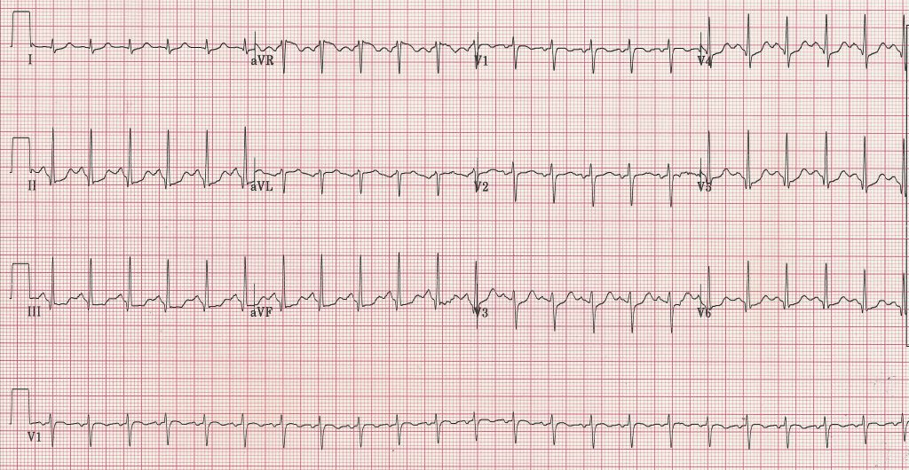
Case Study #5
What does the patient’s 12-lead show?

Slide 107
Case Study #5
12-Lead ECG interpretation
  Sinus tachycardia at 138 bpm
  PR interval 122 ms
  QRS 76 ms
  QT/QTc 290/439 ms
  P-R-T axes 81 85 44
Interpretation
  Sinus tachycardia, nonspecific ST abnormality

Slide 108
Case Study #5
Describe your immediate general treatment for this patient.

Slide 109
Case Study #5
Obtain a 12-lead ECG (already done) and categorize the patient into one of three groups:
  STEMI (characterized by ST-segment elevation)
  High-risk unstable angina/NSTEMI (characterized by ST-segment depression)
  Intermediate or low-risk unstable angina (characterized by normal or nondiagnostic ST-segment or T-wave changes)

Slide 110
Case Study #5
Aspirin + other therapy as appropriate
Obtain complete history and physical exam.
Obtain serum cardiac marker levels.
Serial ECG monitoring
Continue evaluation and treatment in emergency department chest pain unit or monitored bed.
Consider radionuclide imaging, stress echocardiography.

Slide 111
Case Study #6

Slide 112
Case Study #6
A 60-year-old man is complaining of a sudden onset of chest pressure.
He states his symptoms started about 15 minutes ago while dancing and have not subsided with rest.

Slide 113
Case Study #6
The patient points to the center of his chest to show you the location of his pain. He says it does not radiate.
He rates his pain 7/10.
He took two aspirins about 20 minutes ago.

Slide 114
Case Study #6
The patient is 6 feet and weighs 210 pounds.
He has no significant past medical history and takes no medications regularly.

Slide 115
Case Study #6
Physical examination
Awake and oriented to person, place, time, and event.
Skin: Pale, cool, and moist.
No jugular vein distention.
Breath sounds clear and equal bilaterally.

Slide 116
Case Study #6
Initial vital signs
  Blood pressure 125/79
  Pulse 130
  Ventilatory rate 20
  SpO₂ 98% on room air
7 minutes later
  Blood pressure 117/80
  Pulse 138
  Ventilatory rate 20

Slide 117
Case Study #6
What immediate interventions should be performed for this patient?
Notes:
Initial treatment:
ABCs, oxygen, vascular access, administer aspirin 162 to 325 mg (chewed) if no reason for exclusion. Obtain a 12-lead ECG.

Slide 118
Case Study #6
Supplemental oxygen has been applied.
Vascular access has been obtained.
Cardiac monitor applied.
12-Lead ECG obtained.

Slide 119
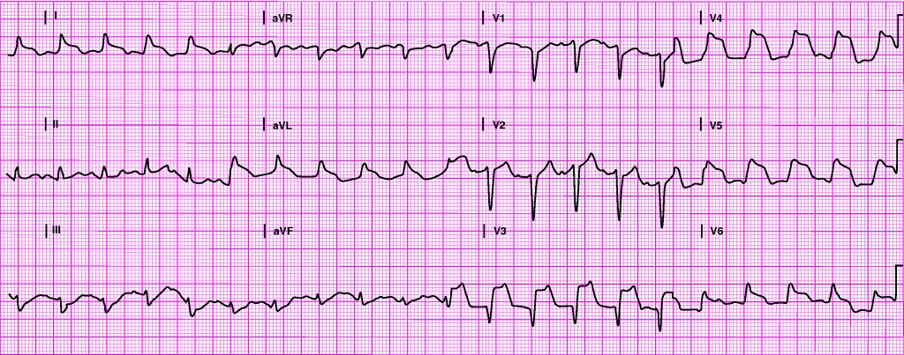
Case Study #6
What does the patient’s 12-lead show?

Slide 120
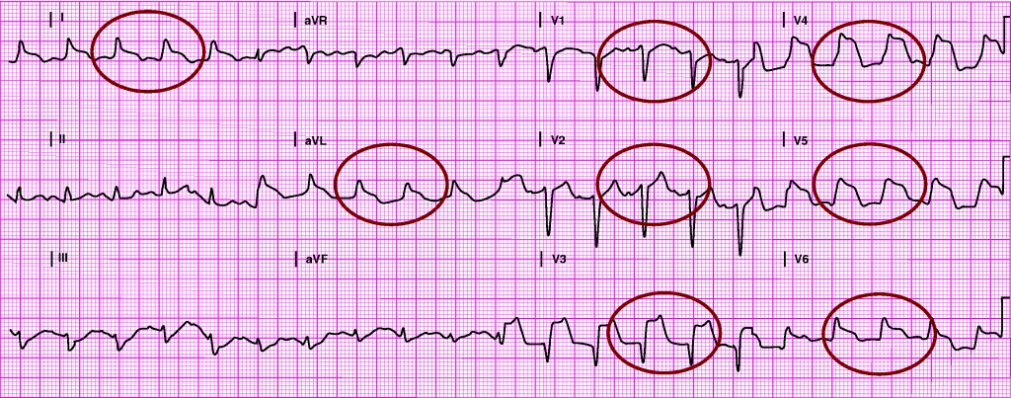
Case Study #6
ST elevation in leads I, aVL, V₁-V₆ suggests an extensive anterior infarction.
Notes:
The patient’s 12-lead ECG shows ST elevation in leads I, aVL, V₁-V₆ suggesting an extensive anterior infarction.

Slide 121
Case Study #6
Describe your immediate general treatment for this patient.

Slide 122
Case Study #6
Reperfusion therapy checklist.
Lab specimens, portable chest radiograph.
Administer medications for pain relief.
  Monitor vital signs closely.
Notes:
The patient’s initial 12-lead ECG shows evidence of a STEMI. Using a reperfusion checklist, begin evaluating the patient for rapid reperfusion therapy (fibrinolytic therapy or percutaneous coronary intervention). Obtain serial 12-lead ECGs, lab specimens (cardiac biomarkers, CBC, lipid profile, electrolytes), and a portable chest radiograph. Administer medications for pain relief as necessary while closely monitoring the patient’s vital signs.

Slide 123
Case Study #7

Slide 124
Case Study #7
A 68-year-old Caucasian woman is complaining of slight shortness of breath and feeling tired.
Her symptoms began about 5 hours ago.

Slide 125
Case Study #7
Past medical history:
  COPD
  Angina
  Hypertension
  Recent respiratory tract infection

Slide 126
Case Study #7
Current medications
  Albuterol
  Atrovent
  Previcid
  Toprol
  Nitroglycerin spray
  Augmentin
Allergies
  Codeine

Slide 127
Case Study #7
The patient states she has used her “puffer” many times since her breathing trouble began earlier today, with only a slight improvement in her breathing.
When asked if she is experiencing any chest discomfort, she replies, “Yes, but that is not uncommon for me.”

Slide 128
Case Study #7
Physical examination
Awake and oriented to person, place, time, and event.
Skin: Pink, warm, and dry.
No jugular vein distention.
Breath sounds reveal inspiratory and expiratory wheezes bilaterally.

Slide 129
Case Study #7
Initial vital signs
  Blood pressure 112/68
  Pulse 65
  Ventilatory rate 22
  SpO₂ 95% on room air
10 minutes later
  Blood pressure 110/62
  Pulse 68
  Ventilatory rate 20

Slide 130
Case Study #7
There are a number of possible causes of the patient’s complaints.
Should myocardial infarction (MI) be considered a possible cause?

Slide 131
Case Study #7
Yes. Although the patient’s symptoms may be due to a condition less serious than MI, the possibility of an MI must be considered.

Slide 132
Case Study #7
Older adults may have atypical symptoms including the following:
  Dyspnea
  Shoulder or back pain
  Weakness
  Fatigue
  Change in mental status
  Syncope
  Unexplained nausea
  Abdominal or epigastric discomfort
Notes:
Older adults may have atypical symptoms such as dyspnea, shoulder or back pain, weakness, fatigue, a change in mental status, syncope, unexplained nausea, and abdominal or epigastric discomfort.

Slide 133
Case Study #7
Older adults are also more likely to present with more severe preexisting conditions, such as hypertension, heart failure, or a previous acute MI, than a younger patient.

Slide 134
Case Study #7
What immediate interventions should be performed for this patient?
Notes:
Initial treatment:
ABCs, oxygen, vascular access, administer aspirin 162 to 325 mg (chewed) if no reason for exclusion. Obtain a 12-lead ECG. Obtain lab specimens (serum cardiac markers, CBC, lipid profile, electrolytes), and a portable chest radiograph.

Slide 135
Case Study #7
Supplemental oxygen has been applied.
Vascular access has been obtained.
Cardiac monitor applied.
12-Lead ECG obtained.
  Obtain previous ECGs, if available.
Aspirin has been administered.
Samples for lab work have been drawn (serum cardiac markers, CBC, lipid profile, electrolytes).
A portable chest radiograph has been obtained.

Slide 136
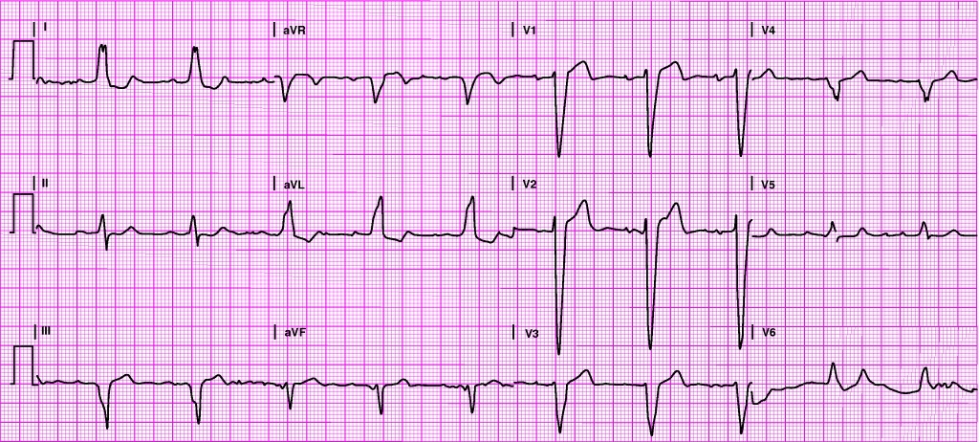
Case Study #7
What does the patient’s 12-lead show?

Slide 137
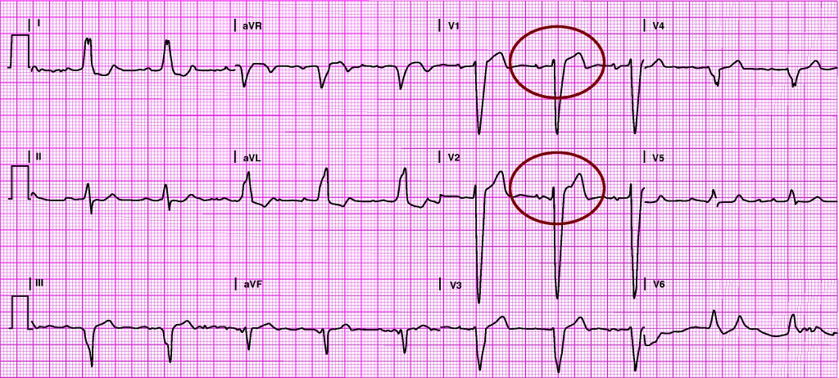
Case Study #7
What does the patient’s 12-lead show?

Slide 138
Case Study #7
Is the ST-segment elevation seen here due to an infarction, or simply part of a left bundle branch block pattern?
Notes:
When bundle branch block is present, ST-segment elevation is often seen in leads with negatively deflected QRS complexes. This situation occurs most frequently in the presence of left bundle branch block and is generally seen in leads V₁, V₂, and V₃, but sometimes extends to V₄ and beyond.

Slide 139
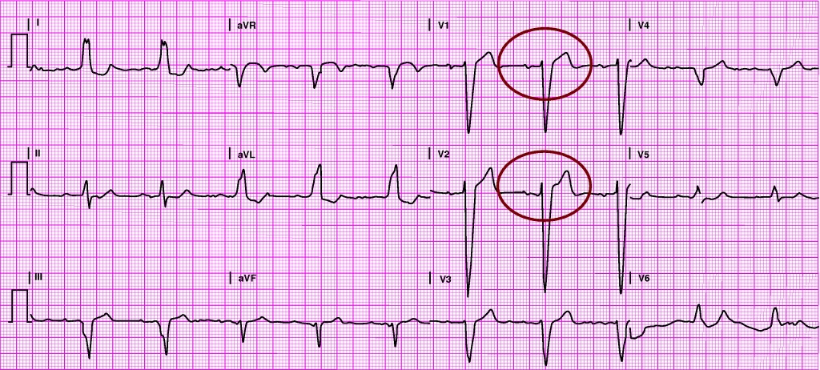
Case Study #7
When bundle branch block is present, ST-segment elevation is often seen in leads with negatively deflected QRS complexes. This situation occurs most frequently in the presence of left bundle branch block and is generally seen in leads V₁, V₂, and V₃ but sometimes extends to V₄ and beyond.
Notes:
When bundle branch block is present, ST-segment elevation is often seen in leads with negatively deflected QRS complexes. This situation occurs most frequently in the presence of left bundle branch block and is generally seen in leads V₁, V₂, and V₃, but sometimes extends to V₄ and beyond.

Slide 140
Case Study #7
In this case, MI was ruled out only after:
  Comparison of this 12-lead with previous tracings
  Serial ECGs
  No elevation of serum cardiac markers

Slide 141
Questions?

Slide 142
Conclusion
Not all STE are due to STEMI
ECG remains a good diagnostic tool, but must be correlated with clinical history and physical examination
Certain characteristics of the ECG changes may aid in the correct diagnosis: morphology, distribution, associated QRS complexes, voltage forces, etc.

Slide 143
Questions?

