Slide 1
Basic 12 Lead EKG
18th Annual
North Douglas County
Rural EMS Retreat
March 2nd, 3rd & 4th, 2018

Slide 2
Jim Cole, LP, MAHE, NRP, FP-C, CEMSO, CMTE
jcole3@peacehealth.org
541-222-1794
Notes:
Describe the ECG characteristics, possible causes, signs and symptoms, and initial emergency care for premature junctional complexes (PJCs).
Describe the ECG characteristics and possible causes for junctional escape beats.
Explain the difference between premature junctional complexes and junctional escape beats.

Slide 3
Objectives
Develop a systematic approach for infarct recognition on the electrocardiogram (ECG).
Gain familiarity with 12-lead ECG interpretation.
Notes:
Describe the ECG characteristics, possible causes, signs and symptoms, and initial emergency care for premature junctional complexes (PJCs).
Describe the ECG characteristics and possible causes for junctional escape beats.
Explain the difference between premature junctional complexes and junctional escape beats.

Slide 4
Five-Step 12-Lead Analysis

Slide 5
Five-Step 12-Lead Analysis
Identify the rate and underlying rhythm.
Analyze waveforms.
Pathologic Q waves
ST-segment elevation
ST-segment depression
Tall, peaked T waves
Inverted T waves

Slide 6
Five-Step 12-Lead Analysis
Examine for evidence of infarction.
Suspected STEMI?
Location?

Slide 7
Five-Step 12-Lead Analysis
Ascertain if STEMI imposters are present that may account for ECG changes.
Left ventricular hypertrophy
Left bundle branch block
Ventricular rhythms
Benign early repolarization
Pericarditis

Slide 8
Five-Step 12-Lead Analysis
Make a STEMI decision.
Definitely NOT a STEMI
Suspected STEMI
Definite maybe

Slide 9
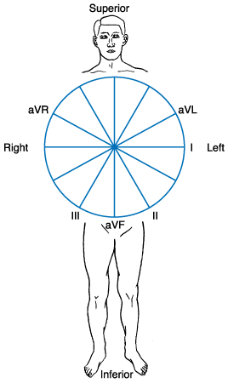
Frontal Plane Leads
View the heart from the front of the body as if it were flat.
Directions
Superior
Inferior
Right
Left
Notes:
Frontal plane leads view the heart from the front of the body. Directions in the frontal plane are superior, inferior, right, and left.

Slide 10
Frontal Plane Leads
Six leads view the heart in the frontal plane
3 bipolar leads
3 unipolar leads
Notes:
Six leads view the heart in the frontal plane as if the body were flat: three bipolar leads and three unipolar leads. Leads I, II, and III are called standard limb leads. Leads aVR, aVL, and aVF are called augmented limb leads.

Slide 11
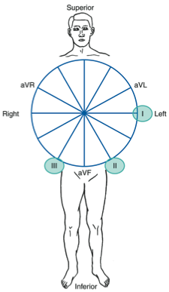
Frontal Plane Leads
Bipolar lead
A lead that consists of a positive and negative electrode.
All ECG leads are bipolar.
Leads I, II, and III use two distinct electrodes.
Notes:
A bipolar lead is an ECG lead that has a positive and negative electrode. Each lead records the difference in electrical potential (voltage) between two selected electrodes. Although all ECG leads are bipolar, Leads I, II, and III use two distinct electrodes, one of which is connected to the positive input of the ECG machine and the other to the negative input.

Slide 12
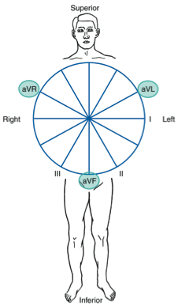
Frontal Plane Leads
Unipolar lead
A lead that consists of a single positive electrode and a reference point.
Augmented limb leads
Leads aVR, aVL, and aVF
Notes:
A lead that consists of a single positive electrode and a reference point is called a unipolar lead. These leads are also called unipolar limb leads or augmented limb leads. The reference point (with zero electrical potential) lies in the center of the heart’s electrical field (left of the interventricular septum and below the AV junction).

Slide 13
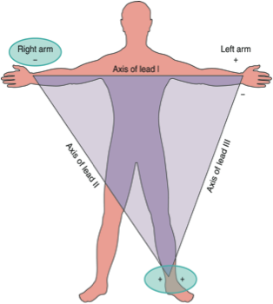
Standard Limb Leads
Leads I, II, and III
Right arm electrode is always negative.
Left leg electrode is always positive.
Notes:
Leads I, II, and III make up the standard limb leads. If an electrode is placed on the right arm, left arm, and left leg, three leads are formed. An imaginary line joining the positive and negative electrodes of a lead is called the axis of the lead. The axes of these three limb leads form an equilateral triangle with the heart at the center (Einthoven's triangle). Although placement of the left leg electrode may appear to make the triangle out of balance, it is nevertheless an equilateral triangle because all electrodes are about equidistant from the electrical field of the heart [1].
Einthoven's triangle is a means of illustrating that the two arms and the left leg form apices of a triangle surrounding the heart. The two apices at the upper part of the triangle represent the points at which the two arms connect electrically with the fluids around the heart. The lower apex is the point at which the left leg connects with the fluids [2].
[1] Conover M: Understanding Electrocardiography, ed 7, St. Louis, 1996, Mosby.
[2] Guyton AC, Hall JE: Textbook of Medical Physiology, ed 9, Philadelphia, 1996, W. B. Saunders Company.

Slide 14
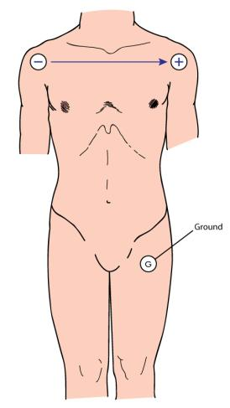
Lead I
Records difference in electrical potential between left arm (+) and right arm (–) electrodes
Views lateral wall of left ventricle
Notes:
14
Lead I records the difference in electrical potential between the left arm (+) and right arm (–) electrodes. The positive electrode is placed on the left arm and the negative electrode is placed on the right arm. The third electrode is a ground that minimizes electrical activity from other sources. Lead I views the lateral surface of the left ventricle.

Slide 15
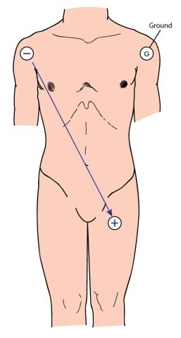
Lead II
Records difference in electrical potential between left leg (+) and right arm (–) electrodes
Views inferior surface of left ventricle
Notes:
15
Lead II records the difference in electrical potential between the left leg (+) and right arm (–) electrodes. The positive electrode is placed on the left leg and the negative electrode is placed on the right arm. Lead II views the inferior surface of the left ventricle. This lead is commonly used for cardiac monitoring because positioning of the positive and negative electrodes in this lead most closely resembles the normal pathway of current flow in the heart.

Slide 16
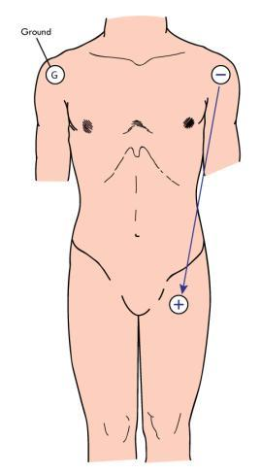
Lead III
Records difference in electrical potential between left leg (+) and left arm (–) electrodes
Views inferior surface of left ventricle
Notes:
16
Lead III records the difference in electrical potential between the left leg (+) and left arm (–) electrodes. In lead III the positive electrode is placed on the left leg and the negative electrode is placed on the left arm. Lead III views the inferior surface of the left ventricle.

Slide 17
Standard Limb Leads
Lead
Positive
Electrode
Negative
Electrode
Heart
Surface
Viewed
I
Left arm
Right arm
Lateral
II
Left leg
Right arm
Inferior
III
Left leg
Left arm
Inferior
Notes:
17

Slide 18
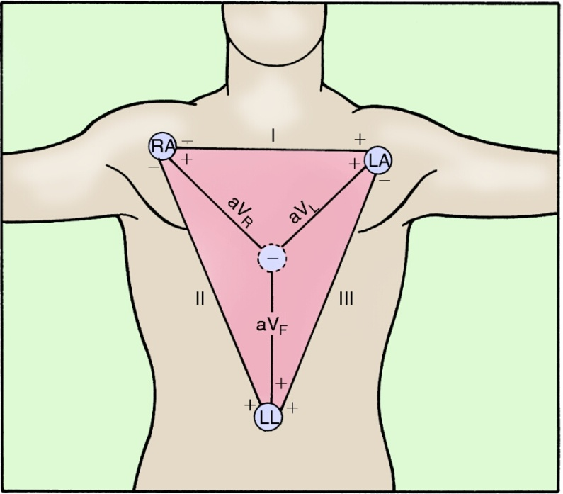
Augmented Limb Leads
Leads aVR, aVL, aVF
A = augmented
V = voltage
R = right arm
L = left arm
F = foot (usually left leg)
Notes:
18
Leads aVR, aVL, and aVF are augmented limb leads that record measurements at a specific electrode with respect to a reference electrode. Frank Norman Wilson and colleagues used the term central terminal to describe a reference point that is the average of the limb lead electrical potentials. In the augmented leads, the Wilson central terminal (WCT) is calculated by the ECG machine’s computer as an average potential of the electrical currents from the two electrodes other than the one being used as the positive electrode. For example, in lead aVL the positive electrode is located on the patient's left arm. The ECG machine’s computer calculates the central terminal by joining the electrical currents obtained from the electrodes on the patient's right arm and left leg. Lead aVL therefore represents the difference in electrical potential between the left arm and the central terminal. The electrical potential of the central terminal is essentially zero.
The electrical potential produced by the augmented leads is normally relatively small. The ECG machine augments (magnifies) the amplitude of the electrical potentials detected at each extremity by about 50% over those recorded at the standard limb leads. The “a” in aVR, aVL, and aVF refers to augmented. The “V” refers to voltage. The “R” refers to right arm, the “L” to left arm, and the “F” to left foot (leg). Therefore, the positive electrode in aVR is located on the right arm, aVL has a positive electrode at the left arm, and aVF has a positive electrode positioned on the left leg.

Slide 19
Augmented Limb Leads
Lead aVR
Views the heart from the right shoulder
Does not view any wall of the heart
Notes:
19
Lead aVR views the heart from the right shoulder (the positive electrode) and views the base of the heart (primarily the atria and the great vessels). This lead does not view any wall of the heart.

Slide 20
Augmented Limb Leads
Lead aVL
Combines views from the right arm and left leg
Views the heart from the left shoulder
Oriented to the lateral wall of the left ventricle
Notes:
20
Lead aVL combines views from the right arm and left leg, with the “view” being from the left shoulder and oriented to the lateral wall of the left ventricle.

Slide 21
Augmented Limb Leads
Lead aVF
Combines views from the right arm and left arm toward the left leg
Views the heart from the left foot (leg)
Views the inferior surface of the left ventricle
Notes:
21
Lead aVF combines views from the right arm and left arm toward the left leg, viewing the inferior surface of the left ventricle from the left leg.

Slide 22
Augmented Limb Leads
Lead
Positive
Electrode
Heart Surface Viewed
aVR
Right arm
None
aVL
Left arm
Lateral
aVF
Left leg
Inferior
Notes:
22

Slide 23
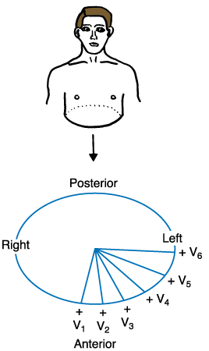
Horizontal Plane Leads
View the heart as if the body were sliced in half horizontally
Directions
Anterior
Posterior
Right
Left
Notes:
23
Horizontal plane leads view the heart as if the body were sliced in half horizontally. Directions in the horizontal plane are anterior, posterior, right, and left.

Slide 24
Horizontal Plane Leads
Six chest (precordial or “V”) leads view the heart in the horizontal plane
Chest leads
V₁
V₂
V₃
V₄
V₅
V₆
Notes:
24
Six chest (precordial or “V”) leads view the heart in the horizontal plane. This allows a view of the front and left side of the heart. The chest leads are identified as V₁, V₂, V₃, V₄, V₅, and V₆. Each electrode placed in a “V” position is a positive electrode, measuring electrical potential with respect to the Wilson central terminal.

Slide 25
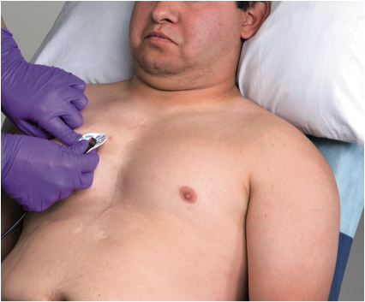
Chest Lead Placement
Notes:
Step 6: V₁ is positioned in the fourth intercostal space just to the right of the sternum. Note: All the electrode positions refer to the location of the gel. For example, the gel of the V₁ electrode, not the entire adhesive patch, is positioned in the fourth intercostal space, just to the right of the sternum.
25

Slide 26
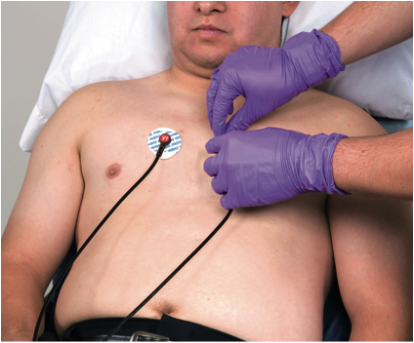
Chest Lead Placement
Notes:
Step 8: Place the V₂ electrode in the fourth intercostal space just to the left of the sternum.
26

Slide 27
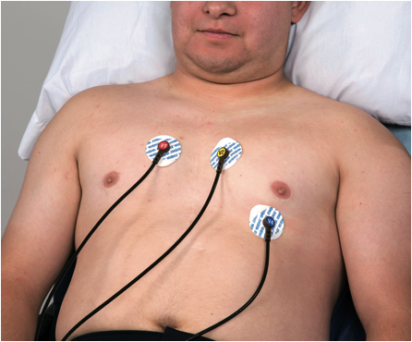
Chest Lead Placement
Notes:
Step 10: Position the V₄ electrode in the fifth intercostal space in the midclavicular line.
27

Slide 28
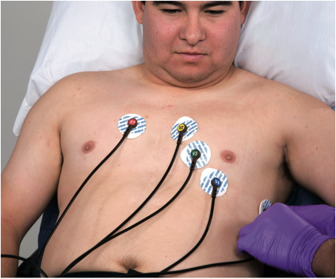
Chest Lead Placement
Notes:
Step 12: V₆ is positioned in the midaxillary line, level with V₄.
28

Slide 29
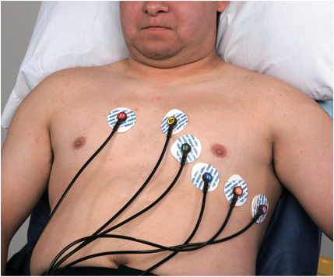
Chest Lead Placement
Notes:
Step 13: V₅ is positioned in the anterior axillary line, level with V₄.
29

Slide 30
Chest Leads
Lead
Positive Electrode Position
Heart Surface Viewed
V₁
Right side of sternum, 4th intercostal space
Septum
V₂
Left side of sternum, 4th intercostal space
Septum
V₃
Midway between V₂ and V₄
Anterior
V₄
Left midclavicular line, 5th intercostal space
Anterior
V₅
Left anterior axillary line; same level as V₄
Lateral
V₆
Left midaxillary line; same level as V₄
Lateral
Notes:
30

Slide 31
Right Chest Leads
Used to view the right ventricle
Placement identical to standard chest leads except on right side of chest
Notes:
31
Other chest leads that are not part of a standard 12-lead ECG may be used to view specific surfaces of the heart. Right chest leads are used to evaluate the right ventricle. Placement of right chest leads is identical to placement of the standard chest leads except it is done on the right side of the chest. If time does not permit obtaining all of the right chest leads, the lead of choice is V₄R. The right chest leads and their placement are:
Lead V₁R Lead V₂
Lead V₂R Lead V₁
Lead V₃R Midway between V₂R and V₄R
Lead V₄R Right midclavicular line, fifth intercostal space
Lead V₅R Right anterior axillary line at same level as V₄R
Lead V₆R Right midaxillary line at same level as V₄R

Slide 32
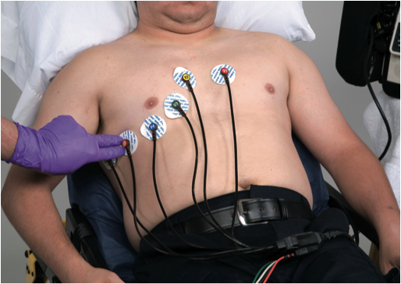
Right Chest Lead Placement
Notes:
Step 6: Position V₅R in the right anterior axillary line, level with V₄R.
32

Slide 33
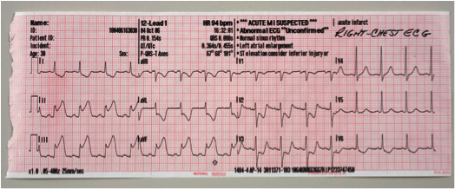
Right Chest Lead Placement
Notes:
Step 7: Once these leads are printed, the correct lead must be handwritten onto the ECG to indicate the origin of the tracing. Clearly label the upper portion of the ECG tracing “right chest ECG.” The computer-generated interpretation also must be disregarded in the event that the cables have been moved.
33

Slide 34
Posterior Chest Leads
Used to view posterior surface of heart
Use same horizontal line as V₄ to V₆
V₇ – posterior axillary line
V₈ – posterior scapular line
V₉ – left border of spine
Notes:
34
On a standard 12-lead ECG, no leads look directly at the posterior surface of the heart. Additional chest leads may be used for this purpose. These leads are placed further left and toward the back. All of the leads are placed on the same horizontal line as V₄ to V₆. Lead V₇ is placed at the posterior axillary line. Lead V₈ is placed at the angle of the scapula (posterior scapular line) and lead V₉ is placed over the left border of spine.

Slide 35
Posterior Chest Lead Placement
Notes:
Step 1: Posterior chest leads are used when a posterior infarction is suspected. First obtain and print a standard 12-lead ECG. Then locate the landmarks for the posterior leads: posterior axillary line, midscapular line, and left border of the spine. Leads V₇, V₈, and V₉ are on the same horizontal line as leads V₄, V₅, and V₆ on the front of the chest.
35

Slide 36
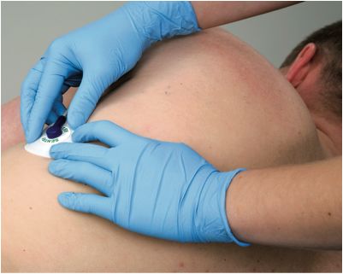
Posterior Chest Lead Placement
Notes:
Step 2: Position the patient on his side. Find the posterior axillary line. Now locate the fifth intercostal space and place the V₇ electrode. Attach the V₄ lead wire to the V₇ electrode.
36

Slide 37
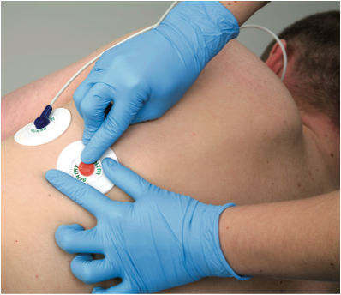
Posterior Chest Lead Placement
Notes:
Step 3: Find the left midscapular line and fifth intercostal space. Place the V₈ electrode here. Attach the V₅ lead wire to the V₈ electrode.
37

Slide 38
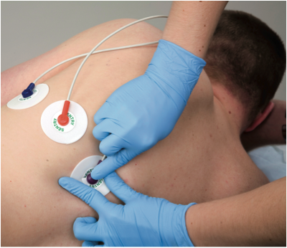
Posterior Chest Lead Placement
Notes:
Step 4: Place the electrode for V₉ just left of the spinal column at the fifth intercostal space. Attach the V₆ lead wire to the V₉ electrode.
38

Slide 39
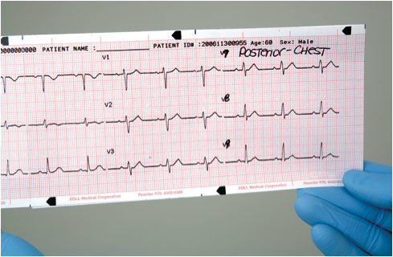
Posterior Chest Lead Placement
Notes:
Step 5: Obtain and print the 12-lead ECG. Clearly label the upper portion of the ECG tracing “posterior chest ECG.” Remember to relabel lead V₄ on the printout V₇, relabel V₅ to V₈, and V₆ to V₉.
39

Slide 40
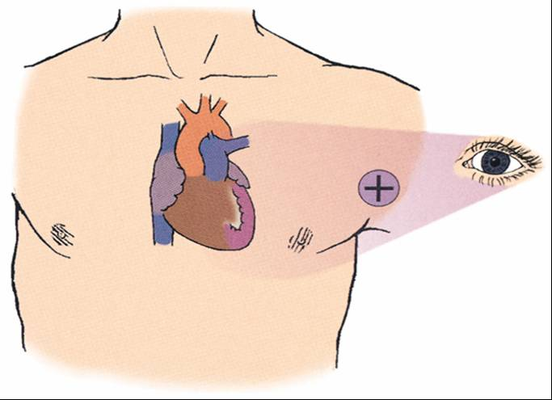
What Each Lead “Sees”
Notes:
Think of the positive electrode as an eye looking in at the heart. The part of the heart that each lead “sees” is determined by two factors. The first factor is the dominance of the left ventricle on the ECG, and the second is the position of the positive electrode on the body. Because the ECG does not directly measure the heart’s electrical activity, it does not “see” all of the current flowing through the heart. What the ECG does see is the net result of countless individual currents competing in a tug-of-war. For example, the QRS complex, which represents ventricular depolarization, is not a display of all the electrical activity occurring in the right and left ventricles. It is the net result of a tug-of-war produced by the many individual currents in both the right and left ventricles. Since the left ventricle is much larger than the right, the left overpowers it. What is seen in the QRS complex is the remaining electrical activity of the left ventricle, i.e., the portion not used to cancel out the right ventricle. Therefore, in a normally conducted beat, the QRS complex represents the electrical activity occurring in the left ventricle (Phalen & Aehlert, 2006).
The second factor, position of the positive electrode on the body, determines which portion of the left ventricle is seen by each lead. You can commit the view of each lead to memory, or you can reason it easily by remembering where the positive electrode is located.
40

Slide 41
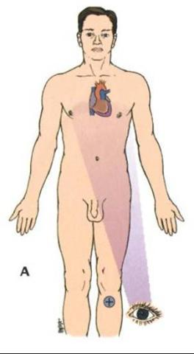
Leads II, III, and aVF
Positive electrode on left leg
Each lead “sees” inferior wall of left ventricle
Notes:
41
Leads II, III, and aVF each have their positive electrode positioned on the left leg. From the perspective of the left leg, each of them “sees” the inferior wall of the left ventricle.

Slide 42
Leads I and aVL
Positive electrode on left arm
Each lead “sees” lateral wall of left ventricle
Notes:
42
From their vantage point on the left arm, leads I and aVL “look” in at the lateral wall of the left ventricle.

Slide 43
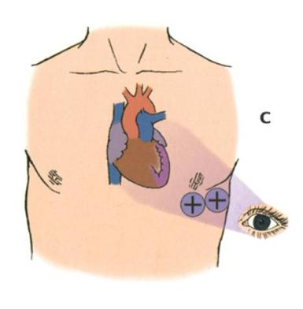
Leads V₅ and V₆
Positive electrode on axillary area of left chest
Each lead “sees” lateral wall of left ventricle
Notes:
43
Leads V₅ and V₆ also “view” the lateral wall because they are positioned on the axillary area of the left chest.

Slide 44
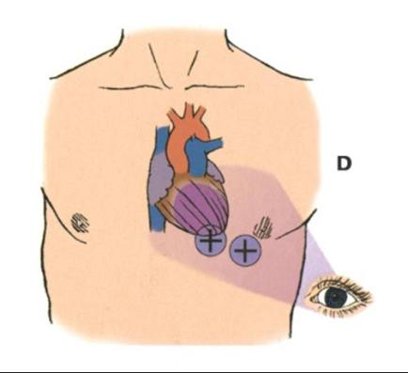
Leads V₃ and V₄
Positive electrode on anterior chest
Each lead “sees” anterior wall of left ventricle
Notes:
44
Leads V₃ and V₄ are positioned in the area of the anterior chest. From this perspective, these leads “see” the anterior wall of the left ventricle.

Slide 45
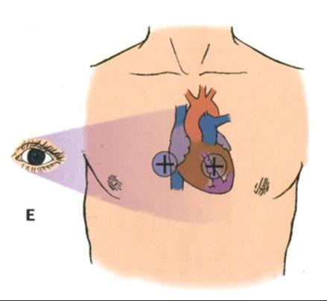
Leads V₁ and V₂
Positive electrode next to sternum
Each lead “sees” septal wall of left ventricle
Notes:
45
The septal wall is “seen” by leads V₁ and V₂, which are positioned next to the sternum.

Slide 46
What Each Lead “Sees” — Summary
Leads | Heart Surface Viewed
II, III, aVF | Inferior
V₁, V₂ | Septal
V₃, V₄ | Anterior
I, aVL, V₅, V₆ | Lateral
Notes:
46

Slide 47
Format of the 12-Lead ECG
Limb Leads |  | Chest Leads
Standard Leads | Augmented Leads | V₁-V₃ | V₄-V₆
Column I | Column II | Column III | Column IV
I Lateral | aVR None | V₁ Septum | V₄ Anterior
II Inferior | aVL Lateral | V₂ Septum | V₅ Lateral
III Inferior | aVF Inferior | V₃ Anterior | V₆ Lateral
Notes:
47

Slide 48
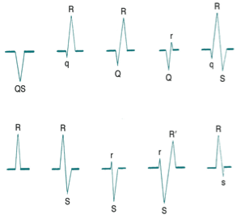
QRS Variations
If the complex consists entirely of a negative waveform, it is called a QS wave.
If the QRS complex consists entirely of a positive waveform, it is called an R wave.
Notes:
48
Although the term QRS complex is used, not every QRS complex contains a Q wave, R wave, and S wave. To review, when the first deflection of the QRS complex is negative (below the baseline), the waveform is called a Q wave. The R wave is the first positive deflection (above the baseline) in the QRS complex. A negative deflection following the R wave is called an S wave.
If the QRS complex consists entirely of a positive waveform, it is called an R wave. If the complex consists entirely of a negative waveform, it is called a QS wave. If there are two positive deflections in the same complex, the second is called R prime and is written R′.

Slide 49
QRS Variations
If there are two positive deflections in the same complex, the second is called R prime and is written as R‘.
If there are two negative deflections following an R wave, the second is written as S‘.
Notes:
49
If there are two positive deflections in the same complex, the second is called R prime and is written R’. If there are two negative deflections following an R wave, the second is called S prime and is written S’. Capital (uppercase) letters are used to designate waveforms of relatively large amplitude, and small (lowercase) letters are used to label relatively small waveforms.

Slide 50
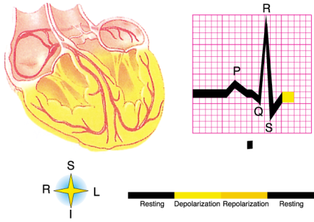
ST Segment
Portion of the ECG tracing between QRS complex and T wave
Represents early part of repolarization of right and left ventricles
Notes:
50
The portion of the ECG tracing between the QRS complex and the T wave is called the ST segment. The term ST segment is used regardless of whether the final wave of the QRS complex is an R or an S wave.

Slide 51
Normal ST Segment
Begins with the end of the QRS complex and ends with the onset of the T wave
ST-segment deviation from the isoelectric line varies and is dependent on patient age, gender, and ECG lead.
Notes:
51
Normal Characteristics of the ST segment
Begins with the end of the QRS complex and ends with the onset of the T wave
ST-segment deviation from the isoelectric line varies and is dependent on patient age, gender, and ECG lead

Slide 52
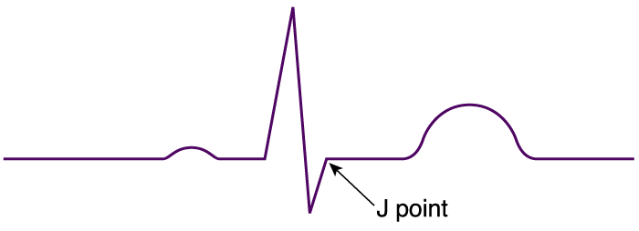
ST Segment
The point at which the QRS complex and the ST segment meet = “ST-junction” or “J-point”
Notes:
52
The point where the QRS complex and the ST segment meet is called the ST-junction or J-point. Various conditions may cause displacement of the ST segment from the isoelectric line in either a positive or negative direction. Myocardial ischemia, injury, and infarction are among the causes of ST-segment deviation.

Slide 53
ST-Segment Deviation
ST segment elevation
ST segment depression
Notes:
Some displacement of the ST segment from the isoelectric line is normal and dependent on age, gender, and ECG lead. For men 40 years of age and older, the threshold value for abnormal J-point elevation is 2 mm in leads V₂ and V₃ and 1 mm in all other leads.
For men less than 40 years of age, the threshold value for abnormal J-point elevation in leads V₂ and V₃ is 2.5 mm.
For women, the threshold value for abnormal J-point elevation is 1.5 mm in leads V₂ and V₃ and greater than 1 mm in all other leads.
For men and women, the threshold for abnormal J-point elevation in V₃R and V₄R is 0.5 mm, except for males less than 30 years of age, for whom 1 mm is more appropriate.
For men and women, the threshold value for abnormal J-point elevation in leads V₇ through V₉ is 0.5 mm.
For men and women of all ages, ST-segment depression of more than 0.5 mm in leads V₂ and V₃ and more than 1 mm in all other leads suggests myocardial ischemia.
53

Slide 54
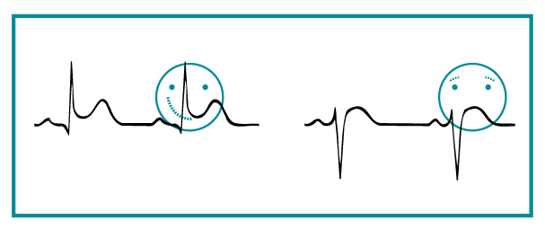
ST-Segment Elevation
Notes:
54
ST-segment elevation in the shape of a “smiley” face (upward concavity) is usually benign, particularly when it occurs in an otherwise healthy, asymptomatic patient. The appearance of coved (“frowny face”) ST-segment elevation is called an acute injury pattern. Other causes of ST-segment elevation may represent a normal variant, pericarditis, or ventricular aneurysm, among other causes. Acute pericarditis causes ST-segment elevation in all or virtually all leads.

Slide 55
Abnormal ST Segments
ST-segment depression of more than 0.5 mm in leads V₂ and V₃ and more than 1 mm in all other leads
Suggestive of myocardial ischemia
ST-segment elevation varies
Dependent on patient age, gender, and ECG lead
A horizontal ST segment is suggestive of ischemia
Digitalis causes depression of ST segment
“Dig dip”
Notes:
ST-segment depression of more than 0.5 mm in leads V₂ and V₃ and more than 1 mm in all other leads is suggestive of myocardial ischemia.
ST-segment elevation varies and is dependent on patient age, gender, and ECG lead.
A horizontal ST segment (forming a sharp angle with the T wave) is suggestive of ischemia.
Digitalis causes a depression (scoop) of the ST segment sometimes referred to as a “dig dip.”
55

Slide 56
Intervals
Interval
A waveform and a segment
Important intervals
PR interval
QT interval
Notes:
56

Slide 57
Practice ECGs
Note: In the following slides, blank areas within the interpretation answers are intentional. ST elevation, depression, or T-wave changes may be present, but not enough to meet established criteria.

Slide 58
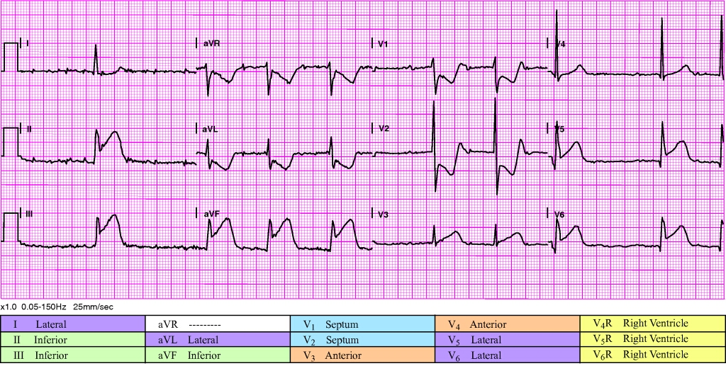
Rate and rhythm? | ________________ | Voltage criteria for LVH? | ________________
Pathologic Q waves? | Leads: __________ | QRS width? | ________________
ST-segment elevation? | Leads: __________ | Reciprocal changes? | ________________
ST-segment depression? | Leads: __________ | STEMI? | Suspected  Definite no  Definite maybe 
T-wave changes? | Leads: __________ | Interpretation: ____________________________________________

Slide 59
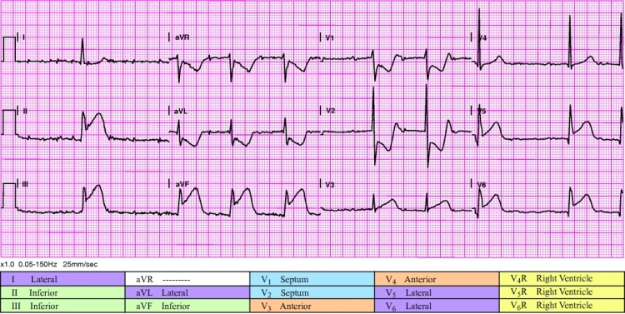
Rate and rhythm? | Supraventricular bradycardia at 52 bpm | Voltage criteria for LVH? | No
Pathologic Q waves? |  | QRS width? | 108 ms
ST-segment elevation? | II, III, aVF, V₃, V_{5,} V₆ | Reciprocal changes? | aVL
ST-segment depression? | aVL, V₁, V₂ | STEMI? | Yes
T-wave changes? | Inverted in aVL, V₁, V₂
Interpretation: STEMI, inferolateral. ST elevation noted in II, III, aVF, V₃, V₅ and V₆. Second-degree type I AV block present, probably nodal. Does not meet voltage criteria for LVH, QRS duration within normal limits. Obvious reciprocal changes present. ST depression and tall R wave in V₁-V₂ suggestive of posterior wall involvement. As with all inferior STEMI, obtain V₄R to assess for right ventricular infarction. Note: ST elevation in V₃ probably due right coronary artery supplying a portion of the ventricular apex.
• PR interval 0 ms • P-QRS-T axes 999, 62, 87 |  | • QRS duration 108 ms • QT/QTc 480/460 ms

Slide 60
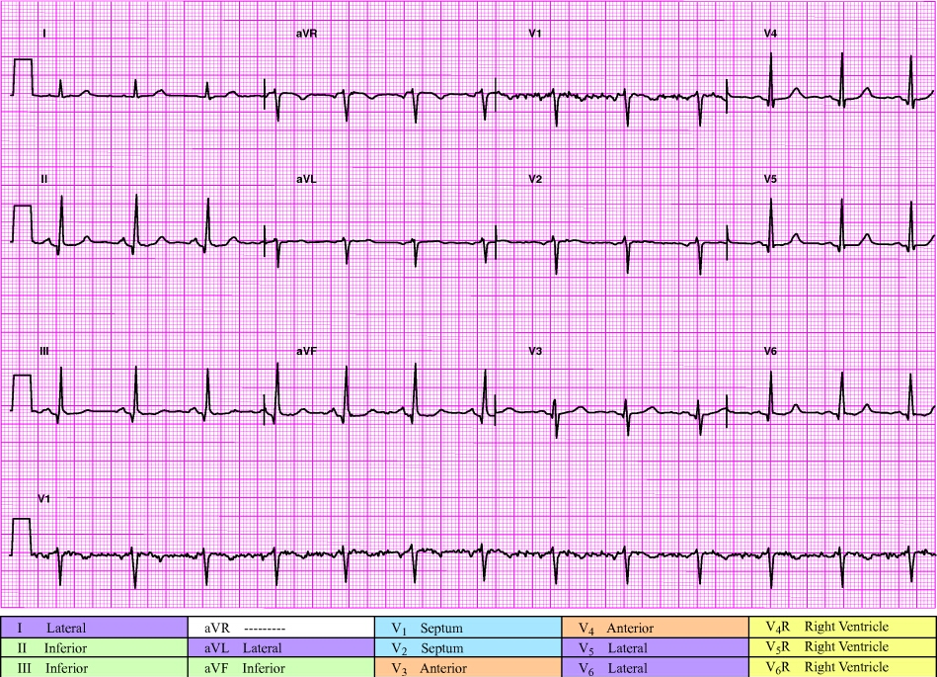
Rate and rhythm? | ________________ | Voltage criteria for LVH? | ________________
Pathologic Q waves? | Leads: __________ | QRS width? | ________________
ST-segment elevation? | Leads: __________ | Reciprocal changes? | ________________
ST-segment depression? | Leads: __________ | STEMI? | Suspected  Definite no  Definite maybe 
T-wave changes? | Leads: __________ | Interpretation: ____________________________________________

Slide 61
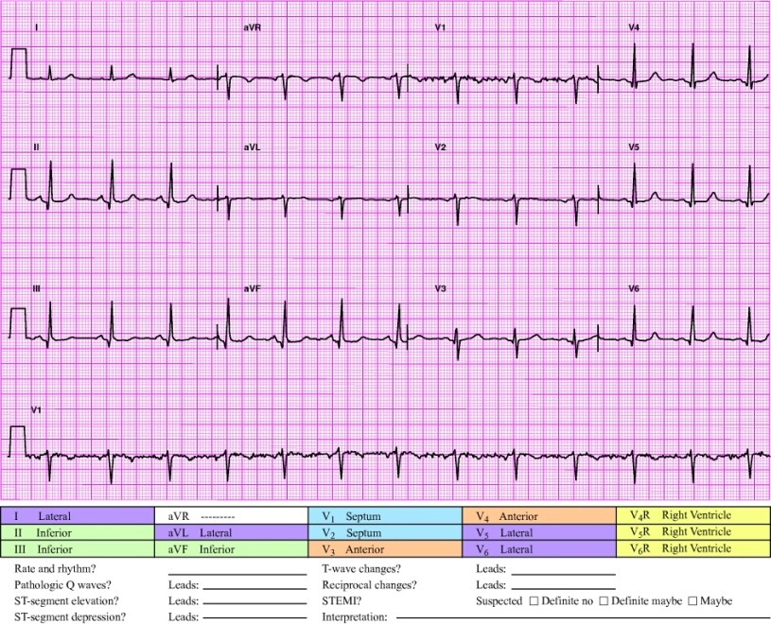
Rate and rhythm? | Sinus rhythm at 75 bpm | Voltage criteria for LVH? | No
Pathologic Q waves? |  | QRS width? | 80 ms
ST-segment elevation? |  | Reciprocal changes? | No
ST-segment depression? |  | STEMI? | No
T-wave changes?
Interpretation: Normal ECG, artifact in aVR, no ECG evidence of STEMI.
• PR interval 160 ms • P-QRS-T axes 62, 42, 31 |  | • QRS duration 80 ms • QT/QTc 414/462 ms

Slide 62
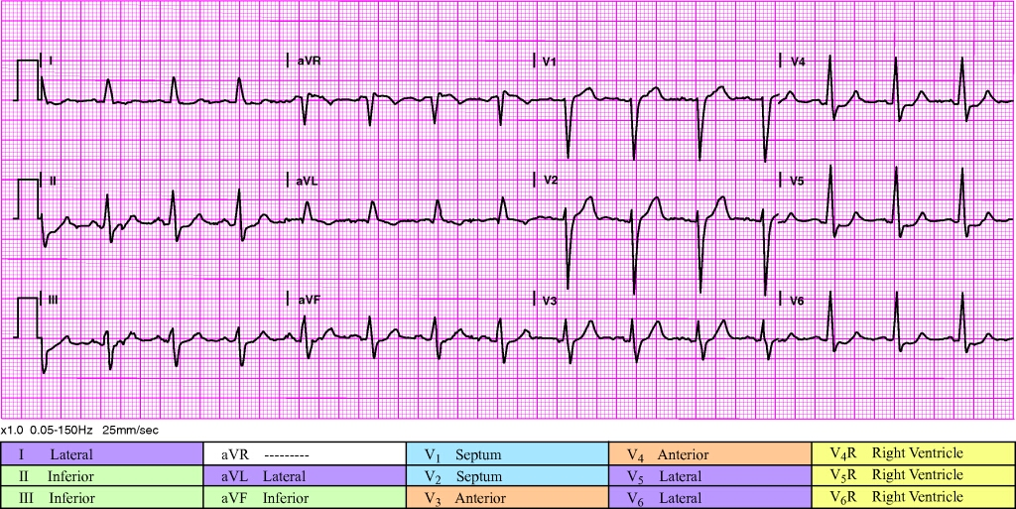
Rate and rhythm? | ________________ | Voltage criteria for LVH? | ________________
Pathologic Q waves? | Leads: __________ | QRS width? | ________________
ST-segment elevation? | Leads: __________ | Reciprocal changes? | ________________
ST-segment depression? | Leads: __________ | STEMI? | Suspected  Definite no  Definite maybe 
T-wave changes? | Leads: __________ | Interpretation: ____________________________________________

Slide 63
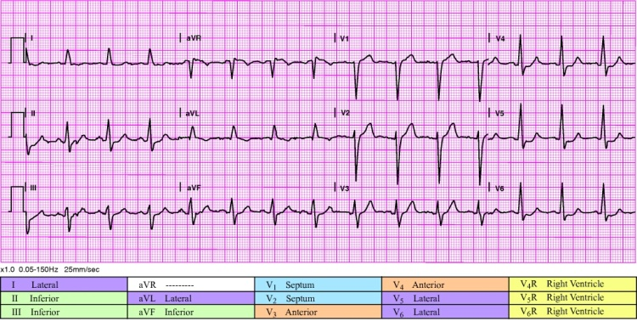
Rate and rhythm? | Sinus rhythm at 90 bpm | Voltage criteria for LVH? | No
Pathologic Q waves? |  | QRS width? | 112 ms
ST-segment elevation? | Slight in aVR and V₁ | Reciprocal changes? | No
ST-segment depression? | II, III, aVL, aVF, V₃, V₄, V₅, V₆ | STEMI? | No
T-wave changes?
Interpretation: Incomplete left bundle branch block (105+ ms QRS duration, 80+ ms Q/S in V₁/V₂, no Q and 60+ ms R in I/aVL/V₅/V₆), moderate ST depression (0.05+ mV ST depression) in most leads. No ECG evidence of STEMI. Note slight ST elevation in aVR and V₁. ST depression in 8 or more leads plus slight ST elevation in aVR and V₁ is associated with either three-vessel disease or a left main occlusion.
• PR interval 180 ms • P-QRS-T axes 70, 6, 79 |  | • QRS duration 112 ms • QT/QTc 368/416 ms

Slide 64
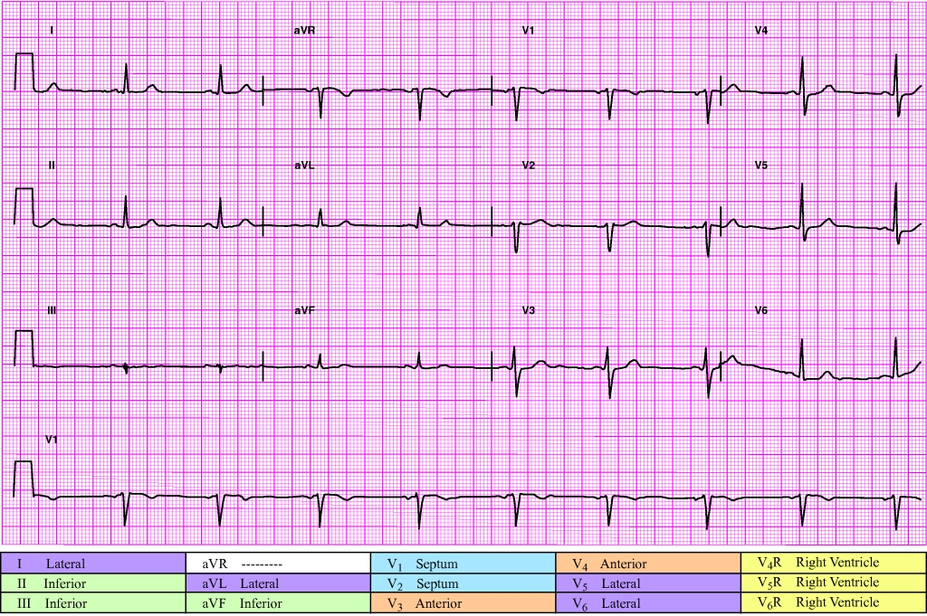
Rate and rhythm? | ________________ | Voltage criteria for LVH? | ________________
Pathologic Q waves? | Leads: __________ | QRS width? | ________________
ST-segment elevation? | Leads: __________ | Reciprocal changes? | ________________
ST-segment depression? | Leads: __________ | STEMI? | Suspected  Definite no  Definite maybe 
T-wave changes? | Leads: __________ | Interpretation: ____________________________________________

Slide 65
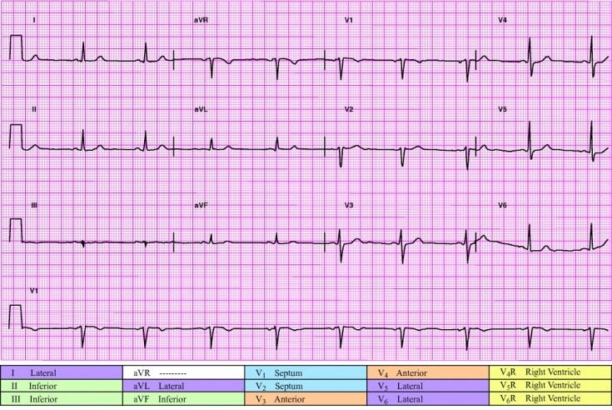
Rate and rhythm? | Sinus bradycardia at 56 bpm | Voltage criteria for LVH? | No
Pathologic Q waves? |  | QRS width? | 100 ms
ST-segment elevation? |  | Reciprocal changes? | No
ST-segment depression? |  | STEMI? | No
T-wave changes? | Inverted in V₁
Interpretation: Sinus bradycardia, otherwise normal ECG. No ECG evidence of STEMI.
• PR interval 126 ms • P-QRS-T axes 51, 24, 29 |  | • QRS duration 100 ms • QT/QTc 432/416 ms

Slide 66
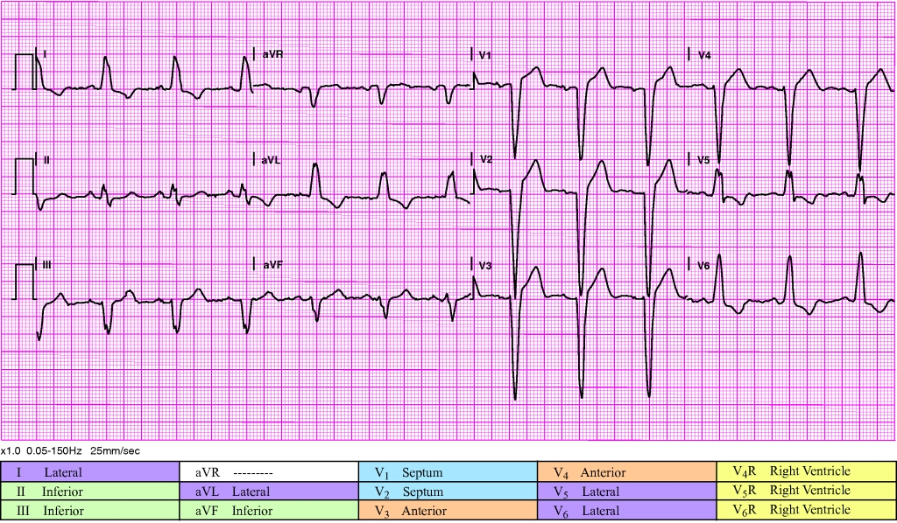
Rate and rhythm? | ________________ | Voltage criteria for LVH? | ________________
Pathologic Q waves? | Leads: __________ | QRS width? | ________________
ST-segment elevation? | Leads: __________ | Reciprocal changes? | ________________
ST-segment depression? | Leads: __________ | STEMI? | Suspected  Definite no  Definite maybe 
T-wave changes? | Leads: __________ | Interpretation: ____________________________________________

Slide 67
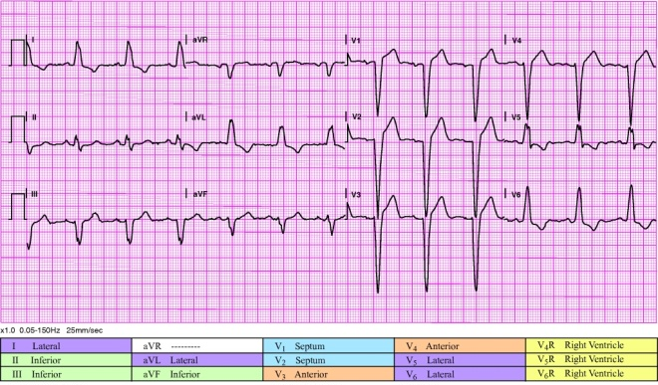
Rate and rhythm? | Sinus rhythm at 76 bpm with left bundle branch block | Voltage criteria for LVH? | No
Pathologic Q waves? |  | QRS width? | 144 ms
ST-segment elevation? | V₁, V₂, V₃, V₄ | Reciprocal changes?
ST-segment depression? |  | STEMI? | Possible STEMI/(Definite maybe)
T-wave changes? | Inverted in I, aVL, V₅, V₆
Interpretation: Possible STEMI/new-onset LBBB (120+ ms QRS duration, 80+ ms Q/S in V₁/V₂, 85+ ms R in I/aVL/V₅/V₆). ST elevation in V₁-V₄. QRS wide and LBBB pattern noted. Does not meet the Sgarbossa criteria for infarct-induced LBBB but cannot rule out that possibility. As always, consider clinical presentation and use ST trending or serial ECGs.
• PR interval 176 ms • P-QRS-T axes 63, -24, 121 |  | • QRS duration 144 ms • QT/QTc 424/455 ms

Slide 68
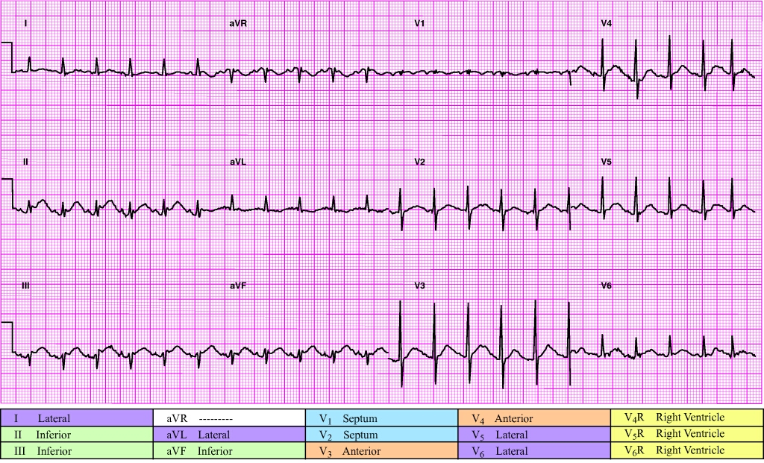
Rate and rhythm? | ________________ | Voltage criteria for LVH? | ________________
Pathologic Q waves? | Leads: __________ | QRS width? | ________________
ST-segment elevation? | Leads: __________ | Reciprocal changes? | ________________
ST-segment depression? | Leads: __________ | STEMI? | Suspected  Definite no  Definite maybe 
T-wave changes? | Leads: __________ | Interpretation: ____________________________________________

Slide 69
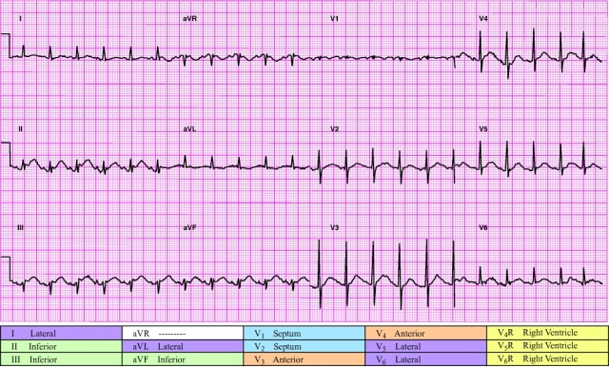
Rate and rhythm? | Sinus tachycardia at 136 bpm with short PR interval, short QT interval | Voltage criteria for LVH? | No
Pathologic Q waves? |  | QRS width? | 76 ms
ST-segment elevation? | II, III, aVF | Reciprocal changes? | I, aVL
ST-segment depression? | I, aVL | STEMI? | Possible STEMI (Definite maybe)
T-wave changes? | Inverted in aVL, V₁
Interpretation: Possible STEMI, inferior. Borderline ST elevation in II, III, aVF. Artifact makes determination of J-point and baseline difficult. Does not meet voltage criteria for LVH. QRS duration within normal limits. ECG not typical for BER, but pericarditis is a possibility given the less than obvious reciprocal changes in aVL and PR segment elevation in aVR. As always, consider clinical presentation and use ST trending or serial ECGs.
• PR interval 116 ms • P-QRS-T axes 59, 2, 77 |  | • QRS duration 76 ms • QT/QTc 228/306 ms

Slide 70
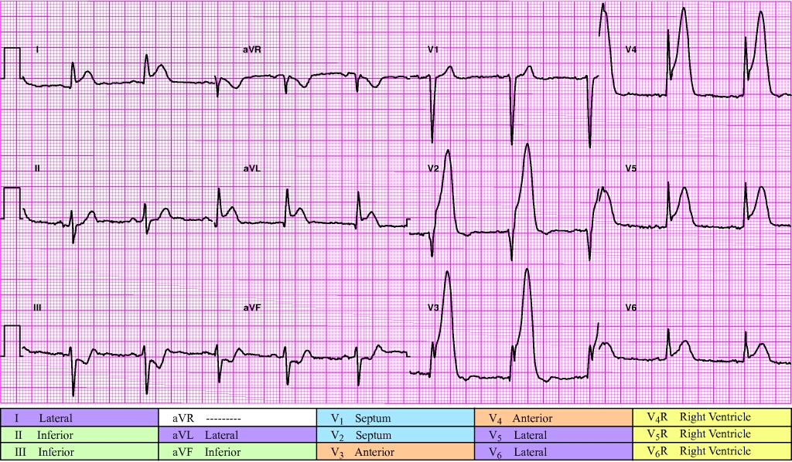
Rate and rhythm? | ________________ | Voltage criteria for LVH? | ________________
Pathologic Q waves? | Leads: __________ | QRS width? | ________________
ST-segment elevation? | Leads: __________ | Reciprocal changes? | ________________
ST-segment depression? | Leads: __________ | STEMI? | Suspected  Definite no  Definite maybe 
T-wave changes? | Leads: __________ | Interpretation: ____________________________________________

Slide 71
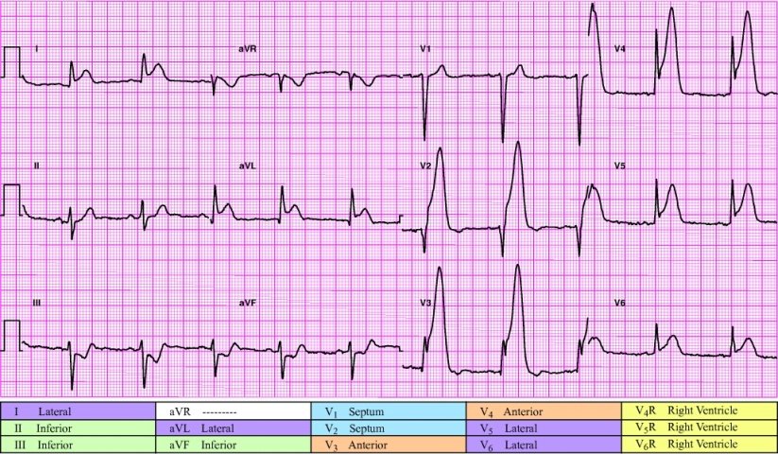
Rate and rhythm? | Sinus rhythm at 62 bpm | Voltage criteria for LVH? | Yes
Pathologic Q waves? |  | QRS width? | 100 ms
ST-segment elevation? | I, aVL, V₂-V₆ | Reciprocal changes? | III, aVF
ST-segment depression? | III, aVF | STEMI? | Yes
T-wave changes? | Tall in V₂-V₅
Interpretation: STEMI, extensive anterolateral. ST elevation noted in I, aVL, V₂-V₆. QRS duration within normal limits. Clear and obvious reciprocal changes present in III and aVF. Meets minimal voltage criteria for LVH, may be normal variant.
• PR interval 192 ms • P-QRS-T axes 66, -29, 35 |  | • QRS duration 100 ms • QT/QTc 388/393 ms

Slide 72
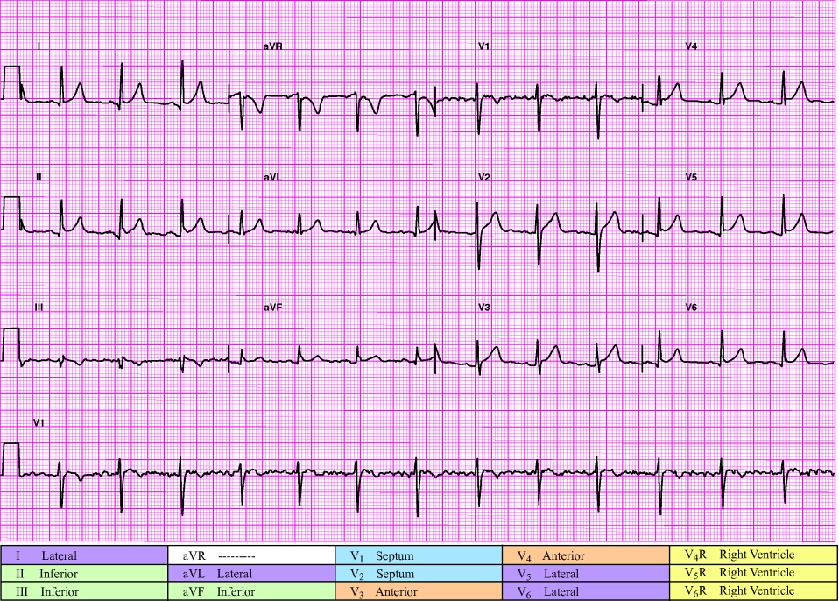
Rate and rhythm? | ________________ | Voltage criteria for LVH? | ________________
Pathologic Q waves? | Leads: __________ | QRS width? | ________________
ST-segment elevation? | Leads: __________ | Reciprocal changes? | ________________
ST-segment depression? | Leads: __________ | STEMI? | Suspected  Definite no  Definite maybe 
T-wave changes? | Leads: __________ | Interpretation: ____________________________________________

Slide 73
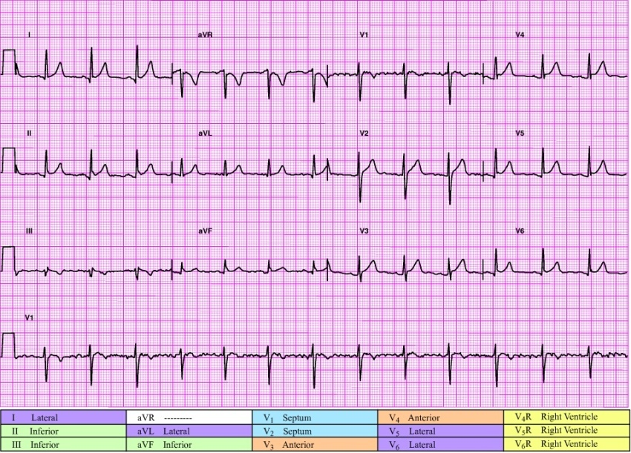
Rate and rhythm? | Sinus rhythm at 79 bpm | Voltage criteria for LVH? |  | No
Pathologic Q waves? |  | QRS width? |  | 82 ms
ST-segment elevation? | V₂-V₆ | Reciprocal changes? |  | No
ST-segment depression? |  | STEMI? |  | No
T-wave changes? | Inverted in III, V₁
Interpretation: No ECG evidence of STEMI. Artifact in V₁. Probable J-point elevation of 1 mm in V₂. ST elevation in V₃-V_{6.} Consider clinical presentation and use ST trending or serial ECGs.
• PR interval 152 ms • P-QRS-T axes 40, 25, 20 |  | • QRS duration 82 ms • QT/QTc 344/401 ms

Slide 74
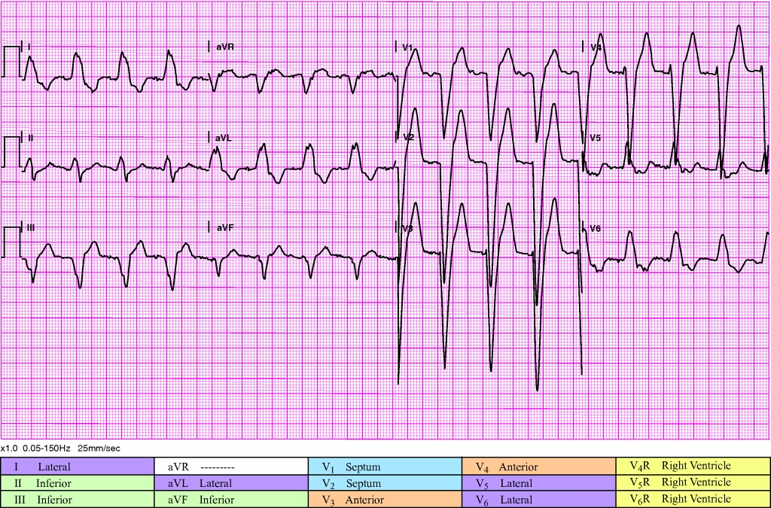
Rate and rhythm? | ________________ | Voltage criteria for LVH? | ________________
Pathologic Q waves? | Leads: __________ | QRS width? | ________________
ST-segment elevation? | Leads: __________ | Reciprocal changes? | ________________
ST-segment depression? | Leads: __________ | STEMI? | Suspected  Definite no  Definite maybe 
T-wave changes? | Leads: __________ | Interpretation: ____________________________________________

Slide 75
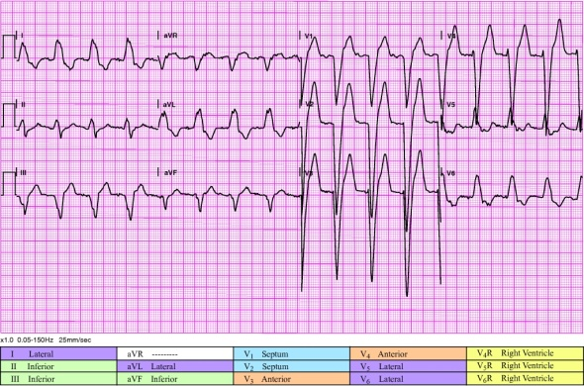
Rate and rhythm? | Sinus rhythm at 98 bpm with LBBB | Voltage criteria for LVH? | No
Pathologic Q waves? |  | QRS width? | 176 ms
ST-segment elevation? | V₁, V₂, V₃, V₄ | Reciprocal changes?
ST-segment depression? |  | STEMI? | Possible STEMI/(Definite maybe)
T-wave changes?
Interpretation: Possible STEMI/new-onset LBBB. ST elevation of 5 mm or more meets Sgarbossa criteria. Note: ST elevation is the least persuasive of Sgarbossa criteria. Always consider proportion of QRS amplitude to amount of ST elevation. In this case, the magnitude of the QRS (approx 40 in V2) calls into question the significance of 7 mm of elevation. Remember: this could very well be new-onset. As always, consider clinical presentation and use ST trending or serial ECGs.
• PR interval 164 ms • P-QRS-T axes 10, -30, 124 |  | • QRS duration 176 ms • QT/QTc 420/475 ms

Slide 76
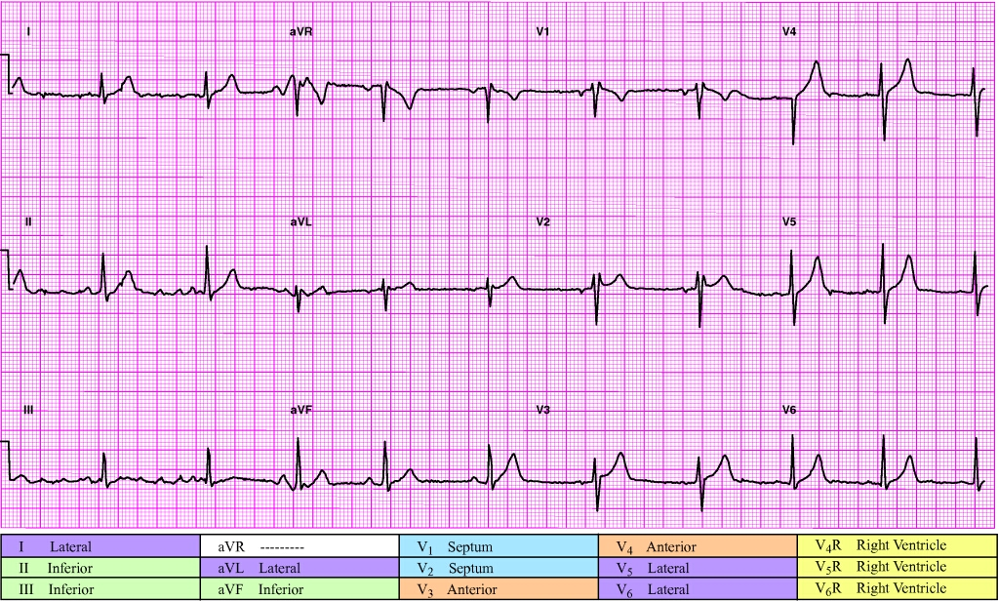
Rate and rhythm? | ________________ | Voltage criteria for LVH? | ________________
Pathologic Q waves? | Leads: __________ | QRS width? | ________________
ST-segment elevation? | Leads: __________ | Reciprocal changes? | ________________
ST-segment depression? | Leads: __________ | STEMI? | Suspected  Definite no  Definite maybe 
T-wave changes? | Leads: __________ | Interpretation: ____________________________________________

Slide 77
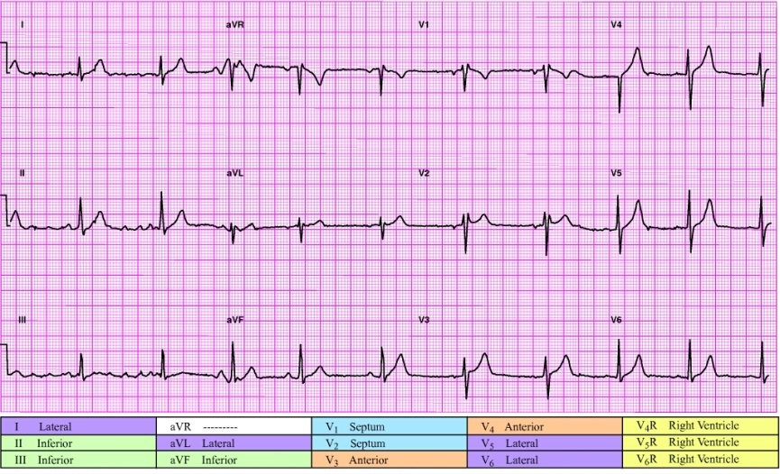
Rate and rhythm? | Sinus rhythm at 69 bpm with occasional premature complexes | Voltage criteria for LVH? | No
Pathologic Q waves? |  | QRS width? | 110 ms
ST-segment elevation? |  | Reciprocal changes? | No
ST-segment depression? |  | STEMI? | No
T-wave changes?
Interpretation: RSR (QR) in V₁/V₂ consistent with right ventricular conduction delay
• PR interval 172 ms • P-QRS-T axes 74, 69, 44 |  | • QRS duration 110 ms • QT/QTc 400/420 ms

Slide 78
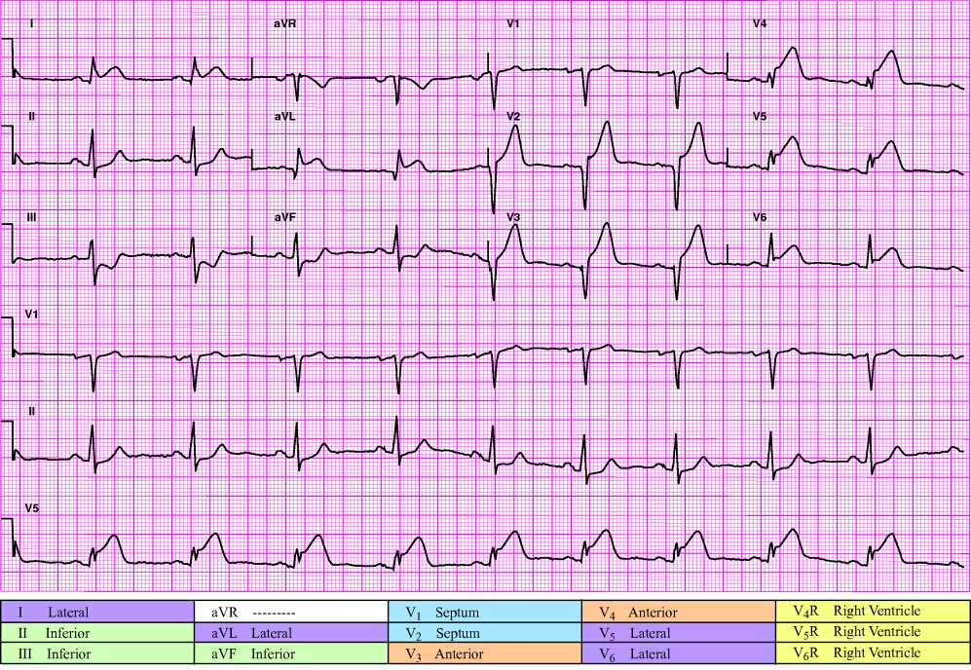
Rate and rhythm? | ________________ | Voltage criteria for LVH? | ________________
Pathologic Q waves? | Leads: __________ | QRS width? | ________________
ST-segment elevation? | Leads: __________ | Reciprocal changes? | ________________
ST-segment depression? | Leads: __________ | STEMI? | Suspected  Definite no  Definite maybe 
T-wave changes? | Leads: __________ | Interpretation: ____________________________________________

Slide 79
Rate and rhythm? | Sinus bradycardia at 58 bpm | Voltage criteria for LVH? | No
Pathologic Q waves? |  | QRS width? | 92 ms
ST-segment elevation? | I, aVL, V₂-V₆ | Reciprocal changes? | II, III, aVF
ST-segment depression? | II, III, aVF | STEMI? | Yes
T-wave changes?
Interpretation: STEMI, extensive anterolateral. ST elevation noted in I, aVL, V₂-V₆. Does not meet voltage criteria for LVH. QRS duration within normal limits. Obvious reciprocal changes in II, III, and aVF.
• PR interval 184 ms • P-QRS-T axes 39, 16, 16 |  | • QRS duration 92 ms • QT/QTc 416/409 ms

Slide 80
Rate and rhythm? | ________________ | Voltage criteria for LVH? | ________________
Pathologic Q waves? | Leads: __________ | QRS width? | ________________
ST-segment elevation? | Leads: __________ | Reciprocal changes? | ________________
ST-segment depression? | Leads: __________ | STEMI? | Suspected  Definite no  Definite maybe 
T-wave changes? | Leads: __________ | Interpretation: ____________________________________________

Slide 81
Rate and rhythm? | Sinus rhythm at 71 bpm |  | Voltage criteria for LVH? | No
Pathologic Q waves? |  |  | QRS width? | 108 ms
ST-segment elevation? | II, III, aVF |  | Reciprocal changes? | aVL
ST-segment depression? | V₂-V₄ |  | STEMI? | Yes
T-wave changes? | Inverted in V₁
Interpretation: STEMI, inferior. ST elevation noted in II, III, and aVF. Does not meet voltage criteria for LVH. QRS duration within normal limits. Reciprocal changes noted in aVL. Obtain V₄R to assess for RVI. ST depression in V₂-V₄ possibly from posterior involvement; consider obtaining posterior leads. Low QRS voltage in limb leads.
• PR interval 192 ms • P-QRS-T axes 43, 44, 38 |  | • QRS duration 108 ms • QT/QTc 376/398 ms

Slide 82
Rate and rhythm? | ________________ | Voltage criteria for LVH? | ________________
Pathologic Q waves? | Leads: __________ | QRS width? | ________________
ST-segment elevation? | Leads: __________ | Reciprocal changes? | ________________
ST-segment depression? | Leads: __________ | STEMI? | Suspected  Definite no  Definite maybe 
T-wave changes? | Leads: __________ | Interpretation: ____________________________________________

Slide 83
Rate and rhythm? | Sinus rhythm at 82 bpm | Voltage criteria for LVH? | No
Pathologic Q waves? |  | QRS width? | 76 ms
ST-segment elevation? | V₁-V₃ | Reciprocal changes? | No
ST-segment depression? |  | STEMI? | Possible STEMI (Definite maybe)
T-wave changes?
Interpretation: Possible STEMI, septal. (ST elevation noted in V₁-V₃). Does not meet voltage criteria for LVH. QRS duration within normal limits. No reciprocal changes noted. This DOES NOT rule out STEMI. Remember, not all STEMI produce reciprocal changes. However, without reciprocal changes BER and pericarditis remain possible explanations for ST elevation. In addition, slight ST elevation in V₁-V₃ can be a normal variant (high take off). As always, consider clinical presentation and use ST trending or serial ECGs.
• PR interval 168 ms • P-QRS-T axes 68, 67, 38 |  | • QRS duration 76 ms • QT/QTc 356/395 ms

Slide 84
Rate and rhythm? | ________________ | Voltage criteria for LVH? | ________________
Pathologic Q waves? | Leads: __________ | QRS width? | ________________
ST-segment elevation? | Leads: __________ | Reciprocal changes? | ________________
ST-segment depression? | Leads: __________ | STEMI? | Suspected  Definite no  Definite maybe 
T-wave changes? | Leads: __________ | Interpretation: ____________________________________________

Slide 85
Rate and rhythm? | Sinus bradycardia at 58 bpm | Voltage criteria for LVH? | No
Pathologic Q waves? |  | QRS width? | 104 ms
ST-segment elevation? | V₁, V₂, V₃ | Reciprocal changes? | II, aVF
ST-segment depression? | III, aVF | STEMI? | Yes
T-wave changes? | Inverted in III, tall in V₂-V₄
Interpretation: STEMI, anteroseptal. Does not meet voltage criteria for LVH. QRS duration within normal limits. Reciprocal changes noted in II and aVF.
• PR interval 168 ms • P-QRS-T axes 18, -53, -14 |  | • QRS duration 104 ms • QT/QTc 436/434 ms

Slide 86
Rate and rhythm? | ________________ | Voltage criteria for LVH? | ________________
Pathologic Q waves? | Leads: __________ | QRS width? | ________________
ST-segment elevation? | Leads: __________ | Reciprocal changes? | ________________
ST-segment depression? | Leads: __________ | STEMI? | Suspected  Definite no  Definite maybe 
T-wave changes? | Leads: __________ | Interpretation: ____________________________________________

Slide 87
Rate and rhythm? | Sinus bradycardia at 53 bpm | Voltage criteria for LVH? | No
Pathologic Q waves? |  | QRS width? | 96 ms
ST-segment elevation? | V₁-V₅ | Reciprocal changes? | II, III, aVF
ST-segment depression? | II, III, aVF | STEMI? | Yes
T-wave changes?
Interpretation: STEMI, anteroseptal. Does not meet voltage criteria for LVH. QRS duration within normal limits. Reciprocal changes noted in II, III, and aVF.
• PR interval 172 ms • P-QRS-T axes 50, 18, -40 |  | • QRS duration 96 ms • QT/QTc 444/427 ms

Slide 88
Figure 8-16
Rate and rhythm? | ________________ | Voltage criteria for LVH? | ________________
Pathologic Q waves? | Leads: __________ | QRS width? | ________________
ST-segment elevation? | Leads: __________ | Reciprocal changes? | ________________
ST-segment depression? | Leads: __________ | STEMI? | Suspected  Definite no  Definite maybe 
T-wave changes? | Leads: __________ | Interpretation: ____________________________________________

Slide 89
Rate and rhythm? | Sinus rhythm at 60 bpm with LBBB | Voltage criteria for LVH? | No
Pathologic Q waves? |  | QRS width? | 136 ms
ST-segment elevation? | III, V₁-V₄ | Reciprocal changes?
ST-segment depression? | I, aVL, V₅, V₆ | STEMI? | Possible STEMI/(Definite maybe)
T-wave changes? | Inverted in I, aVL, V₅, V₆
Interpretation: Possible STEMI/new-onset LBBB. ST elevation noted in V₁-V₄. Does not meet Sgarbossa criteria. As always, consider clinical presentation and use ST trending or serial ECGs. Abnormal left axis deviation.
• PR interval 164 ms • P-QRS-T axes 60, -38, 96 |  | • QRS duration 136 ms • QT/QTc 424/425 ms

Slide 90
Rate and rhythm? | ________________ | Voltage criteria for LVH? | ________________
Pathologic Q waves? | Leads: __________ | QRS width? | ________________
ST-segment elevation? | Leads: __________ | Reciprocal changes? | ________________
ST-segment depression? | Leads: __________ | STEMI? | Suspected  Definite no  Definite maybe 
T-wave changes? | Leads: __________ | Interpretation: ____________________________________________

Slide 91
Rate and rhythm? | Sinus rhythm at 99 bpm | Voltage criteria for LVH? | No
Pathologic Q waves? |  | QRS width? | 84 ms
ST-segment elevation? |  | Reciprocal changes? | No
ST-segment depression? | I, II, aVL, V₄, V₅, V₆ | STEMI? | No
T-wave changes?
Interpretation: No ECG evidence of STEMI. Widespread ST depression noted.
• PR interval 148 ms • P-QRS-T axes 56, 7, 18 |  | • QRS duration 84 ms • QT/QTc 324/380 ms

Slide 92
Rate and rhythm? | ________________ | Voltage criteria for LVH? | ________________
Pathologic Q waves? | Leads: __________ | QRS width? | ________________
ST-segment elevation? | Leads: __________ | Reciprocal changes? | ________________
ST-segment depression? | Leads: __________ | STEMI? | Suspected  Definite no  Definite maybe 
T-wave changes? | Leads: __________ | Interpretation: ____________________________________________

Slide 93
Rate and rhythm? | Sinus tachycardia at 107 bpm | Voltage criteria for LVH? | No
Pathologic Q waves? |  | QRS width? | 100 ms
ST-segment elevation? | II, III, aVF | Reciprocal changes? | I, aVL
ST-segment depression? | I, aVL | STEMI? | Yes
T-wave changes? | Inverted in I, aVL
Interpretation: STEMI, inferior. ST elevation in II, III, and aVF. Does not meet voltage criteria for LVH. QRS duration within normal limits. Reciprocal changes noted (aVL and, to a lesser extent, I). Obtain V₄R to assess for RVI.
• PR interval 192 ms • P-QRS-T axes 75, 82, 92 |  | • QRS duration 100 ms • QT/QTc 332/395 ms

Slide 94
Rate and rhythm? | ________________ | Voltage criteria for LVH? | ________________
Pathologic Q waves? | Leads: __________ | QRS width? | ________________
ST-segment elevation? | Leads: __________ | Reciprocal changes? | ________________
ST-segment depression? | Leads: __________ | STEMI? | Suspected  Definite no  Definite maybe 
T-wave changes? | Leads: __________ | Interpretation: ____________________________________________

Slide 95
Rate and rhythm? | Sinus rhythm at 93 bpm |  | Voltage criteria for LVH? | No
Pathologic Q waves? | V₁-V₄ |  | QRS width? | 100 ms
ST-segment elevation? | V₁-V₄ |  | Reciprocal changes? | III, aVF
ST-segment depression? | II, III, aVF |  | STEMI? | Yes
T-wave changes?
Interpretation: STEMI, anteroseptal. ST elevation noted in V₁-V₄. Does not meet voltage criteria for LVH. QRS duration within normal limits. Artifact makes assessment of reciprocal changes difficult but assumed to be present in III and aVF.
• PR interval 160 ms • P-QRS-T axes 53, 18, 71 |  | QRS duration 100 ms • QT/QTc 376/426 ms

Slide 96
Rate and rhythm? | ________________ | Voltage criteria for LVH? | ________________
Pathologic Q waves? | Leads: __________ | QRS width? | ________________
ST-segment elevation? | Leads: __________ | Reciprocal changes? | ________________
ST-segment depression? | Leads: __________ | STEMI? | Suspected  Definite no  Definite maybe 
T-wave changes? | Leads: __________ | Interpretation: ____________________________________________

Slide 97
Rate and rhythm? | Sinus rhythm at 84 bpm | Voltage criteria for LVH? | No
Pathologic Q waves? |  | QRS width? | 82 ms
ST-segment elevation? |  | Reciprocal changes? | No
ST-segment depression? |  | STEMI? | No
T-wave changes?
Interpretation: Normal ECG, no ECG evidence of STEMI.
• PR interval 156 ms • P-QRS-T axes 81, 75, 65 |  | • QRS duration 82 ms • QT/QTc 340/401 ms

Slide 98
Rate and rhythm? | ________________ | Voltage criteria for LVH? | ________________
Pathologic Q waves? | Leads: __________ | QRS width? | ________________
ST-segment elevation? | Leads: __________ | Reciprocal changes? | ________________
ST-segment depression? | Leads: __________ | STEMI? | Suspected  Definite no  Definite maybe 
T-wave changes? | Leads: __________ | Interpretation: ____________________________________________

Slide 99
Rate and rhythm? | Sinus rhythm at 79 bpm with occasional ectopic premature complexes | Voltage criteria for LVH? | No
Pathologic Q waves? |  | QRS width? | 88 ms
ST-segment elevation? | V₁-V₄ | Reciprocal changes? | III, aVF
ST-segment depression? | II, III, aVF | STEMI? | Yes
T-wave changes? | Tall, peaked in V₂-V₅
Interpretation: STEMI, anteroseptal. ST elevation noted in V₁-V₄. Tall, peaked T waves noted in V₂-V₅. Does not meet voltage criteria for LVH. QRS duration within normal limits. Reciprocal changes noted in III and aVF.
• PR interval 168 ms • P-QRS-T axes 78, 45, 18 |  | • QRS duration 88 ms • QT/QTc 364/399 ms

Slide 100
Rate and rhythm? | ________________ | Voltage criteria for LVH? | ________________
Pathologic Q waves? | Leads: __________ | QRS width? | ________________
ST-segment elevation? | Leads: __________ | Reciprocal changes? | ________________
ST-segment depression? | Leads: __________ | STEMI? | Suspected  Definite no  Definite maybe 
T-wave changes? | Leads: __________ | Interpretation: ____________________________________________

Slide 101
Rate and rhythm? | Sinus rhythm at 71 bpm with first-degree AV block | Voltage criteria for LVH? | Yes
Pathologic Q waves? | V₁-V₃ | QRS width? | 84 ms
ST-segment elevation? | V₂, V₃ | Reciprocal changes?
ST-segment depression? | V₅, V₆ | STEMI? | Suspected STEMI
T-wave changes?
Interpretation: Possible STEMI, anteroseptal. ST elevation seen in V₂, V₃. NOTE: these leads are contiguous. Artifact makes exact identification of J-point and TP segment difficult. QS complexes (counts as a pathologic Q wave) noted in V₁-V₃. Consider STEMI versus normal variant versus previous acute MI with ventricular aneurysm. As always, consider clinical presentation and use ST trending or serial ECGs.
• PR interval 212 ms • P-QRS-T axes 55, -25, 40 |  | • QRS duration 84 ms • QT/QTc 408/430 ms

Slide 102
Rate and rhythm? | ________________ | Voltage criteria for LVH? | ________________
Pathologic Q waves? | Leads: __________ | QRS width? | ________________
ST-segment elevation? | Leads: __________ | Reciprocal changes? | ________________
ST-segment depression? | Leads: __________ | STEMI? | Suspected  Definite no  Definite maybe 
T-wave changes? | Leads: __________ | Interpretation: ____________________________________________

Slide 103
Rate and rhythm? | Sinus rhythm at 73 bpm with premature atrial complexes | Voltage criteria for LVH? | No
Pathologic Q waves? |  | QRS width? | 90 ms
ST-segment elevation? |  | Reciprocal changes? | No
ST-segment depression? |  | STEMI? | No
T-wave changes?
Interpretation: Normal ECG, no ECG evidence of STEMI noted. As always, consider clinical presentation and use ST trending or serial ECGs.
• PR interval 156 ms • P-QRS-T axes 20, 53, 37 |  | • QRS duration 90 ms • QT/QTc 408/449 ms

Slide 104
Rate and rhythm? | ________________ | Voltage criteria for LVH? | ________________
Pathologic Q waves? | Leads: __________ | QRS width? | ________________
ST-segment elevation? | Leads: __________ | Reciprocal changes? | ________________
ST-segment depression? | Leads: __________ | STEMI? | Suspected  Definite no  Definite maybe 
T-wave changes? | Leads: __________ | Interpretation: ____________________________________________

Slide 105
Rate and rhythm? | Sinus tachycardia at 107 bpm | Voltage criteria for LVH? | No
Pathologic Q waves? |  | QRS width? | 64 ms
ST-segment elevation? |  | Reciprocal changes? | No
ST-segment depression? |  | STEMI? | No
T-wave changes?
Interpretation: Nonspecific T-wave abnormality, no ECG evidence of STEMI noted. As always, consider clinical presentation and use ST trending or serial ECGs.
• PR interval 148 ms • P-QRS-T axes 51, 16, 88 |  | • QRS duration 64 ms • QT/QTc 318/418 ms

Slide 106
Rate and rhythm? | ________________ | Voltage criteria for LVH? | ________________
Pathologic Q waves? | Leads: __________ | QRS width? | ________________
ST-segment elevation? | Leads: __________ | Reciprocal changes? | ________________
ST-segment depression? | Leads: __________ | STEMI? | Suspected  Definite no  Definite maybe 
T-wave changes? | Leads: __________ | Interpretation: ____________________________________________

Slide 107
Rate and rhythm? | Sinus rhythm at 75 bpm with LBBB | Voltage criteria for LVH? | No
Pathologic Q waves? |  | QRS width? | 144 ms
ST-segment elevation? | V₁-V₃ | Reciprocal changes?
ST-segment depression? | V₅-V₆ | STEMI? | Possible STEMI/(Definite maybe)
T-wave changes?
Interpretation: Possible STEMI/new-onset LBBB. Does not meet Sgarbossa criteria. As always, consider clinical presentation and use ST trending or serial ECGs.
• PR interval 130 ms • P-QRS-T axes 13, -16, 58 |  | • QRS duration 144 ms • QT/QTc 406/453 ms

Slide 108
Rate and rhythm? | ________________ | Voltage criteria for LVH? | ________________
Pathologic Q waves? | Leads: __________ | QRS width? | ________________
ST-segment elevation? | Leads: __________ | Reciprocal changes? | ________________
ST-segment depression? | Leads: __________ | STEMI? | Suspected  Definite no  Definite maybe 
T-wave changes? | Leads: __________ | Interpretation: ____________________________________________

Slide 109
Rate and rhythm? | Sinus arrhythmia at 67 bpm | Voltage criteria for LVH? | No
Pathologic Q waves? |  | QRS width? | 66 ms
ST-segment elevation? |  | Reciprocal changes? | No
ST-segment depression? | III | STEMI? | No
T-wave changes? | Inverted in V₁
Interpretation: Normal ECG, no ECG evidence of STEMI noted. As always, consider clinical presentation and use ST trending or serial ECGs.
• PR interval 164 ms • P-QRS-T axes 81, 84, 61 |  | • QRS duration 66 ms • QT/QTc 392/414 ms

Slide 110
Rate and rhythm? | ________________ | Voltage criteria for LVH? | ________________
Pathologic Q waves? | Leads: __________ | QRS width? | ________________
ST-segment elevation? | Leads: __________ | Reciprocal changes? | ________________
ST-segment depression? | Leads: __________ | STEMI? | Suspected  Definite no  Definite maybe 
T-wave changes? | Leads: __________ | Interpretation: ____________________________________________

Slide 111
Rate and rhythm? | Sinus rhythm at 74 bpm with right bundle branch block (RBBB) | Voltage criteria for LVH? | No
Pathologic Q waves? | III, aVF | QRS width? | 130 ms
ST-segment elevation? |  | Reciprocal changes?
ST-segment depression? |  | STEMI? | Possible STEMI/(Definite maybe)
T-wave changes? | Inverted V₁, V₂
Interpretation: Possible STEMI. RBBB pattern noted. While no ECG evidence exists to suspect STEMI, the RBBB is capable of diminishing ST elevation that might otherwise be present. For that reason consider STEMI “possible.” As always, consider clinical presentation and use ST trending or serial ECGs. Artifact in V₁, baseline wander in V₂.
• PR interval 168 ms • P-QRS-T axes 60, -21, 46 |  | • QRS duration 130 ms • QT/QTc 388/430 ms

Slide 112
Rate and rhythm? | ________________ | Voltage criteria for LVH? | ________________
Pathologic Q waves? | Leads: __________ | QRS width? | ________________
ST-segment elevation? | Leads: __________ | Reciprocal changes? | ________________
ST-segment depression? | Leads: __________ | STEMI? | Suspected  Definite no  Definite maybe 
T-wave changes? | Leads: __________ | Interpretation: ____________________________________________

Slide 113
Rate and rhythm? | Sinus rhythm at 86 bpm | Voltage criteria for LVH? | No
Pathologic Q waves? |  | QRS width? | 92 ms
ST-segment elevation? | V₁-V₅ | Reciprocal changes? | III, subtle in II and aVF
ST-segment depression? |  | STEMI? | Yes
T-wave changes? | Inverted in III; tall, peaked in V₂-V₄
Interpretation: STEMI, anteroseptal. ST elevation noted in V₁-V₅. Tall, peaked T waves in V₂-V₄. Does not meet voltage criteria for LVH. QRS duration within normal limits. Reciprocal changes noted in III, subtle changes in II and aVF. Baseline wander in V₆.
• PR interval 144 ms • P-QRS-T axes 47, 60, -6 |  | • QRS duration 92 ms • QT/QTc 352/395 ms

Slide 114
Rate and rhythm? | ________________ | Voltage criteria for LVH? | ________________
Pathologic Q waves? | Leads: __________ | QRS width? | ________________
ST-segment elevation? | Leads: __________ | Reciprocal changes? | ________________
ST-segment depression? | Leads: __________ | STEMI? | Suspected  Definite no  Definite maybe 
T-wave changes? | Leads: __________ | Interpretation: ____________________________________________

Slide 115
Rate and rhythm? | Sinus bradycardia at 43 bpm | Voltage criteria for LVH? | No
Pathologic Q waves? |  | QRS width? | 108 ms
ST-segment elevation? | V₂ | Reciprocal changes? | No
ST-segment depression? |  | STEMI? | No
T-wave changes? | Inverted in V₁
Interpretation: No ECG evidence of STEMI noted. ST elevation present in V₂. ST elevation of less than 1 mm noted in V₃. Normal variant versus early stage of evolving STEMI. As always, consider clinical presentation and use ST trending or serial ECGs.
• PR interval 188 ms • P-QRS-T axes 61, 48, 38 |  | • QRS duration 108 ms • QT/QTc 484/430 ms

Slide 116
Rate and rhythm? | ________________ | Voltage criteria for LVH? | ________________
Pathologic Q waves? | Leads: __________ | QRS width? | ________________
ST-segment elevation? | Leads: __________ | Reciprocal changes? | ________________
ST-segment depression? | Leads: __________ | STEMI? | Suspected  Definite no  Definite maybe 
T-wave changes? | Leads: __________ | Interpretation: ____________________________________________

Slide 117
Rate and rhythm? | Atrial fibrillation at 107 bpm | Voltage criteria for LVH? | No
Pathologic Q waves? |  | QRS width? | 90 ms
ST-segment elevation? |  | Reciprocal changes? | No
ST-segment depression? | V₆ | STEMI? | No
T-wave changes? | Tall in V₂
Interpretation: No ECG evidence of STEMI. Incomplete RBBB pattern (RSR’ pattern in V₁ but QRS less than 120 ms). Baseline wander in I, V₄-V₆. As always, consider clinical presentation and use ST trending or serial ECGs.
• PR interval None • P-QRS-T axes None, 69, 17 |  | • QRS duration 90 ms • QT/QTc 304/405 ms

Slide 118
Rate and rhythm? | ________________ | Voltage criteria for LVH? | ________________
Pathologic Q waves? | Leads: __________ | QRS width? | ________________
ST-segment elevation? | Leads: __________ | Reciprocal changes? | ________________
ST-segment depression? | Leads: __________ | STEMI? | Suspected  Definite no  Definite maybe 
T-wave changes? | Leads: __________ | Interpretation: ____________________________________________

Slide 119
Rate and rhythm? | Sinus rhythm at 73 bpm with LBBB | Voltage criteria for LVH? | No
Pathologic Q waves? |  | QRS width? | 144 ms
ST-segment elevation? | V₁, V₂ | Reciprocal changes?
ST-segment depression? | I, II, aVL, aVF, V₅, V₆ | STEMI? | Possible STEMI/(Definite maybe)
T-wave changes?
Interpretation: Possible STEMI/new-onset LBBB. ST elevation noted in V₁-V₂. LBBB pattern also noted. Does not meet Sgarbossa criteria. As always, consider clinical presentation and use ST trending or serial ECGs.
• PR interval 136 ms • P-QRS-T axes 28, -5, 238 |  | • QRS duration 144 ms • QT/QTc 438/482 ms

Slide 120
Rate and rhythm? | ________________ | Voltage criteria for LVH? | ________________
Pathologic Q waves? | Leads: __________ | QRS width? | ________________
ST-segment elevation? | Leads: __________ | Reciprocal changes? | ________________
ST-segment depression? | Leads: __________ | STEMI? | Suspected  Definite no  Definite maybe 
T-wave changes? | Leads: __________ | Interpretation: ____________________________________________

Slide 121
Rate and rhythm? | Sinus bradycardia at 58 bpm | Voltage criteria for LVH? | No
Pathologic Q waves? |  | QRS width? | 86 ms
ST-segment elevation? |  | Reciprocal changes? | No
ST-segment depression? |  | STEMI? | No
T-wave changes?
Interpretation: No ECG evidence of STEMI noted. As always, consider clinical presentation and use ST trending or serial ECGs.
• PR interval 122 ms • P-QRS-T axes 41, 54, 22 |  | • QRS duration 86 ms • QT/QTc 416/408 ms

Slide 122
Rate and rhythm? | ________________ | Voltage criteria for LVH? | ________________
Pathologic Q waves? | Leads: __________ | QRS width? | ________________
ST-segment elevation? | Leads: __________ | Reciprocal changes? | ________________
ST-segment depression? | Leads: __________ | STEMI? | Suspected  Definite no  Definite maybe 
T-wave changes? | Leads: __________ | Interpretation: ____________________________________________

Slide 123
Rate and rhythm? | Sinus tachycardia at 100 bpm with ventricular demand pacemaker | Voltage criteria for LVH? | No
Pathologic Q waves? | II, III, aVF, V₁-V₄ | QRS width? | 136 ms
ST-segment elevation? | V₁ | Reciprocal changes?
ST-segment depression? | I, aVL, V₅, V₆ | STEMI? | Possible STEMI
T-wave changes?
Interpretation: Possible STEMI. Ventricular-paced rhythm noted. Does not meet Sgarbossa criteria. Pacemaker can diminish ST elevation that may otherwise be present. For that reason, consider STEMI possible. As always, consider clinical presentation and use ST trending or serial ECGs.
• PR interval 156 ms • P-QRS-T axes -22, -65, 96 |  | • QRS duration 136 ms • QT/QTc 348/405 ms

Slide 124
Rate and rhythm? | ________________ | Voltage criteria for LVH? | ________________
Pathologic Q waves? | Leads: __________ | QRS width? | ________________
ST-segment elevation? | Leads: __________ | Reciprocal changes? | ________________
ST-segment depression? | Leads: __________ | STEMI? | Suspected  Definite no  Definite maybe 
T-wave changes? | Leads: __________ | Interpretation: ____________________________________________

Slide 125
Rate and rhythm? | Sinus rhythm at 83 bpm with first-degree AV block and RBBB | Voltage criteria for LVH? | No
Pathologic Q waves? |  | QRS width? | 156 ms
ST-segment elevation? | III, aVF | Reciprocal changes? | I, aVL
ST-segment depression? | I, aVL, V₃-V₆ | STEMI? | Possible STEMI (Definite maybe)
T-wave changes? | Inverted in I, V₁, V₄-V₆
Interpretation: Possible STEMI. ST elevation noted in III and minimal amount in aVF. RBBB pattern noted. RBBB can cause ST elevation. STEMI versus RBBB. The concordant ST elevation in lead III suggests STEMI. Abnormal right axis deviation.
• PR interval 228 ms • P-QRS-T axes -23, 120, -41 |  | • QRS duration 156 ms • QT/QTc 364/403 ms

Slide 126
Rate and rhythm? | ________________ | Voltage criteria for LVH? | ________________
Pathologic Q waves? | Leads: __________ | QRS width? | ________________
ST-segment elevation? | Leads: __________ | Reciprocal changes? | ________________
ST-segment depression? | Leads: __________ | STEMI? | Suspected  Definite no  Definite maybe 
T-wave changes? | Leads: __________ | Interpretation: ____________________________________________

Slide 127
Rate and rhythm? | Sinus rhythm at 92 bpm | Voltage criteria for LVH? | No
Pathologic Q waves? | II, III, aVF | QRS width? | 108 ms
ST-segment elevation? | II, III, aVF | Reciprocal changes? | aVL
ST-segment depression? | I, aVL, V₁-V₄ | STEMI? | Yes
T-wave changes?
Interpretation: STEMI, inferior. ST elevation noted in II, III, and aVF. Obvious reciprocal change noted in aVL. ST depression in V₁-V₄ suggests possible posterior involvement, consider obtaining posterior leads. Obtain V₄R to assess for RVI. Baseline wander in I, II, III.
• PR interval 152 ms • P-QRS-T axes 63, 55, 89 |  | • QRS duration 108 ms • QT/QTc 360/410 ms

Slide 128
Questions?

